Slide 1
CSCE 689: Special Topics in Modern Algorithms for Data Science
Lecture 23
Samson Zhou

Slide 2
Presentation Schedule
November 27: Chunkai, Jung, Galaxy AI
November 29: STMI, Anmol, Jason
December 1: Bokun, Ayesha, Dawei, Lipai

Slide 4
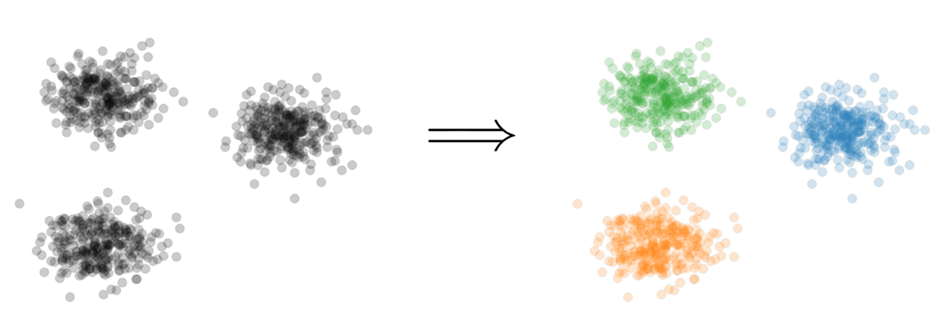

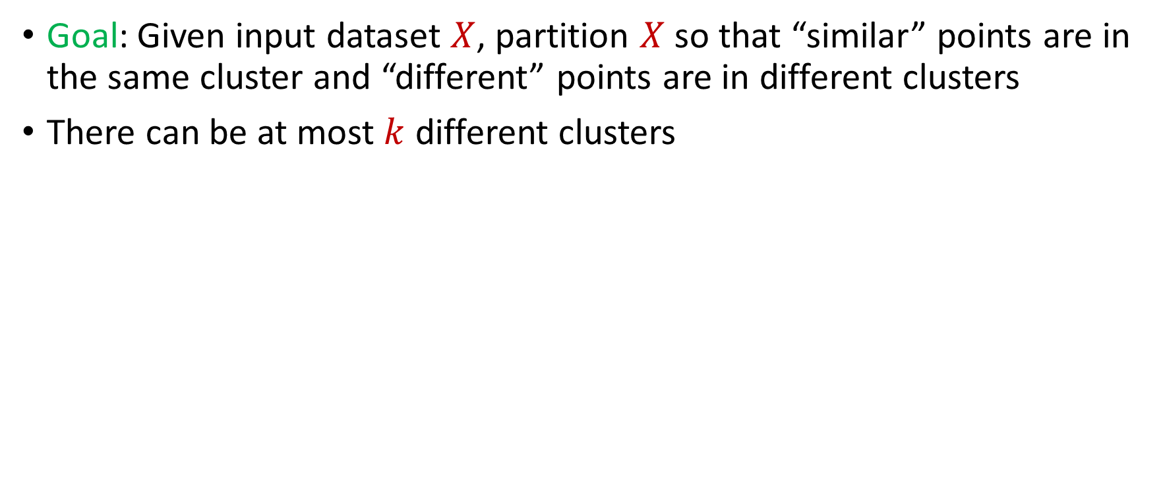
Last Time: $k$-Clustering
Goal: Given input dataset $X$, partition $X$ so that “similar” points are in the same cluster and “different” points are in different clusters
There can be at most $k$ different clusters
$$k=3$$

Slide 5

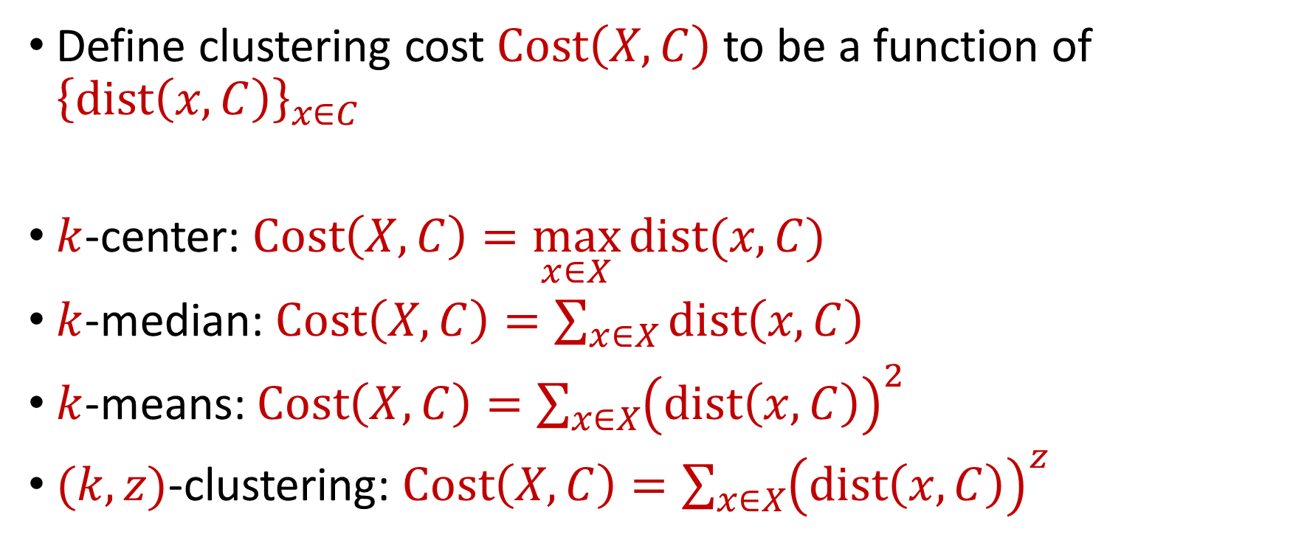






Last Time: $k$-Clustering
Define clustering cost $Cost\left(X,C\right)$ to be a function of ${\left\{dist\left(x,C\right)\right\}}_{x∈C}$
$k$-center: $Cost\left(X,C\right)=\max_{x∈X}{dist(x,C)}$
$k$-median: $Cost\left(X,C\right)=\sum_{x∈X}{dist\left(x,C\right)}$
$k$-means: $Cost\left(X,C\right)=\sum_{x∈X}{{\left(dist\left(x,C\right)\right)}^{2}}$
$(k,z)$-clustering: $Cost\left(X,C\right)=\sum_{x∈X}{{\left(dist\left(x,C\right)\right)}^{z}}$
$${\left(⋅\right)}^{z}$$
$${\left(⋅\right)}^{z}$$
$${\left(⋅\right)}^{z}$$
$${\left(⋅\right)}^{z}$$
$${\left(⋅\right)}^{z}$$
$${\left(⋅\right)}^{z}$$
$${\left(⋅\right)}^{z}$$

Slide 6
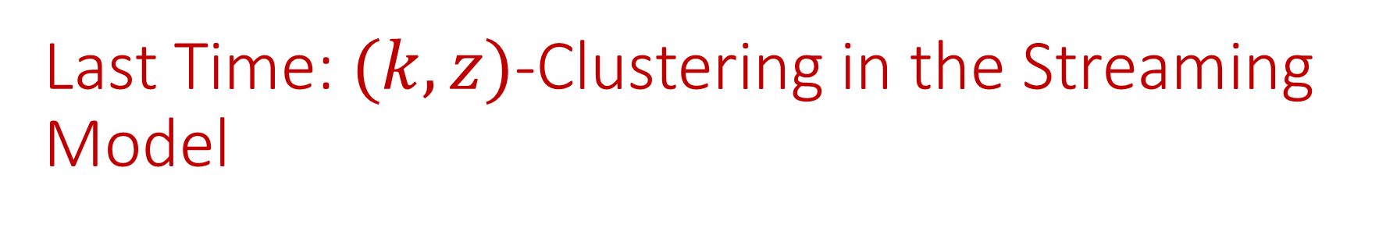
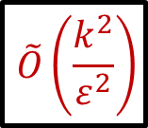
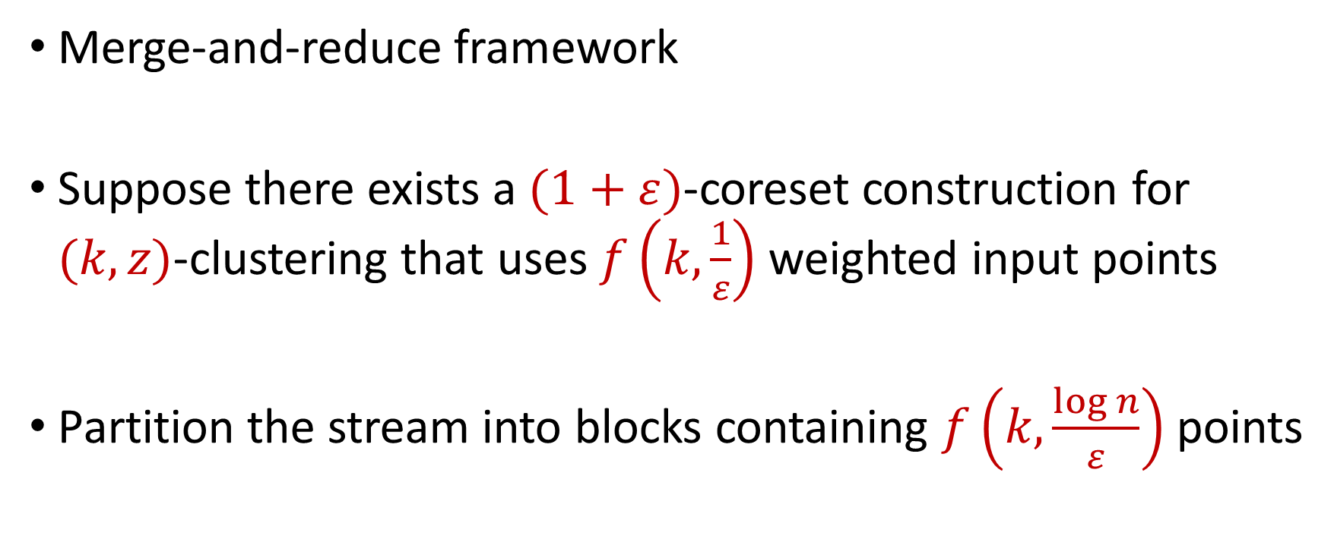
Last Time: $(k,z)$-Clustering in the Streaming Model
Merge-and-reduce framework
Suppose there exists a $(1+ε)$-coreset construction for $(k,z)$-clustering that uses $f\left(k,\frac{1}{ε}\right)$ weighted input points
Partition the stream into blocks containing $f\left(k,\frac{\log{n}}{ε}\right)$ points
$$\tilde{O}\left(\frac{k^{2}}{ε^{2}}\right)$$

Slide 7
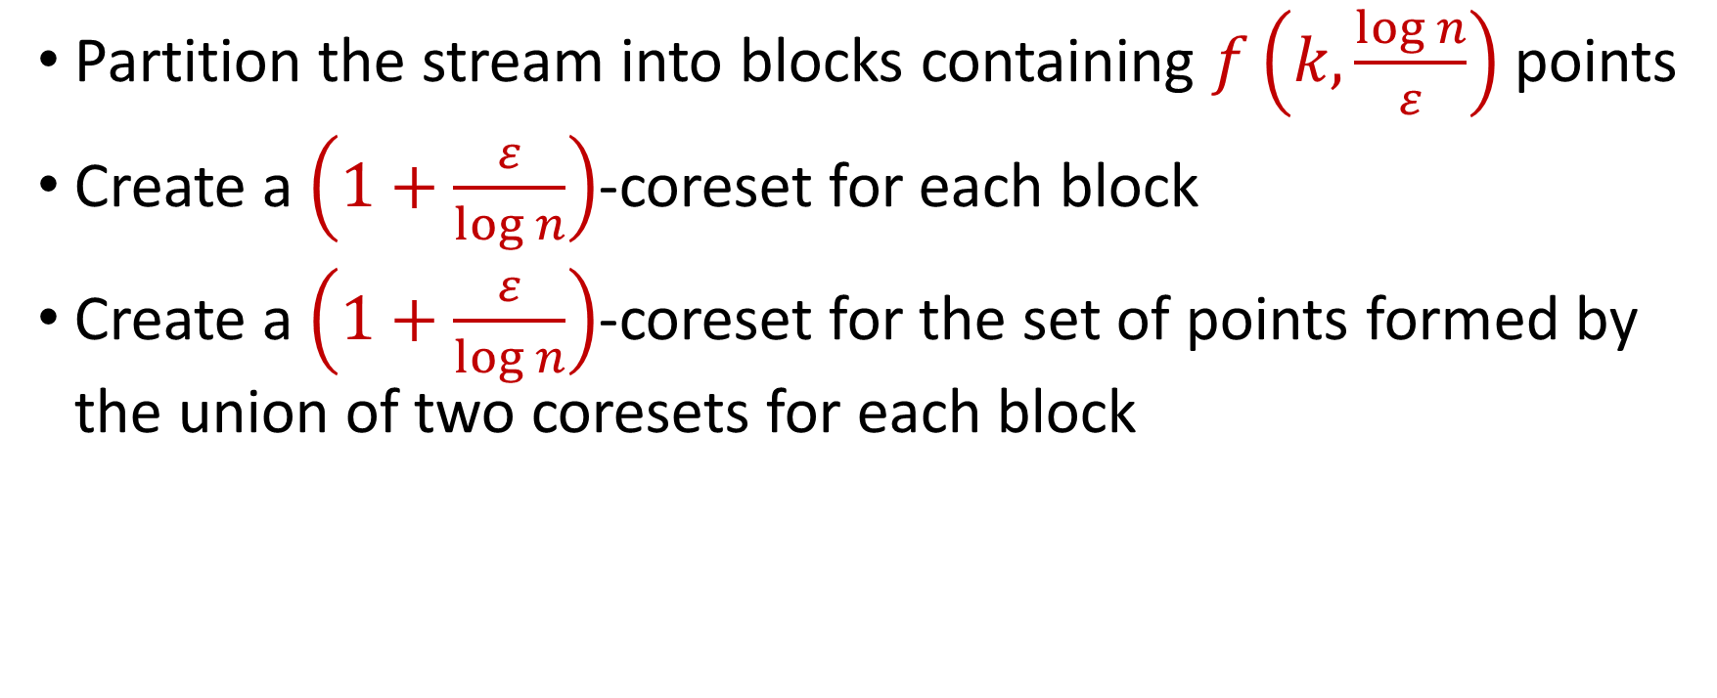
Last Time: $(k,z)$-Clustering in the Streaming Model
Partition the stream into blocks containing $f\left(k,\frac{\log{n}}{ε}\right)$ points
Create a $\left(1+\frac{ε}{\log{n}}\right)$-coreset for each block
Create a $\left(1+\frac{ε}{\log{n}}\right)$-coreset for the set of points formed by the union of two coresets for each block
Reduce
Merge

Slide 8
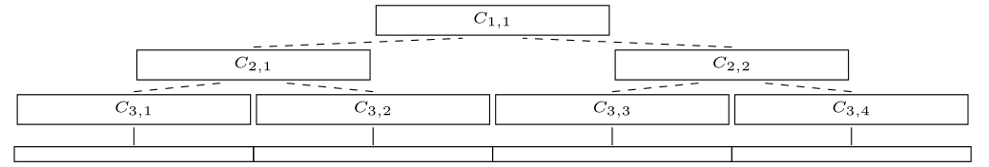
Last Time: $(k,z)$-Clustering in the Streaming Model
Partition the stream into blocks containing $f\left(k,\frac{\log{n}}{ε}\right)$ points
Create a $\left(1+\frac{ε}{\log{n}}\right)$-coreset for each block
Create a $\left(1+\frac{ε}{\log{n}}\right)$-coreset for the set of points formed by the union of two coresets for each block

Slide 9
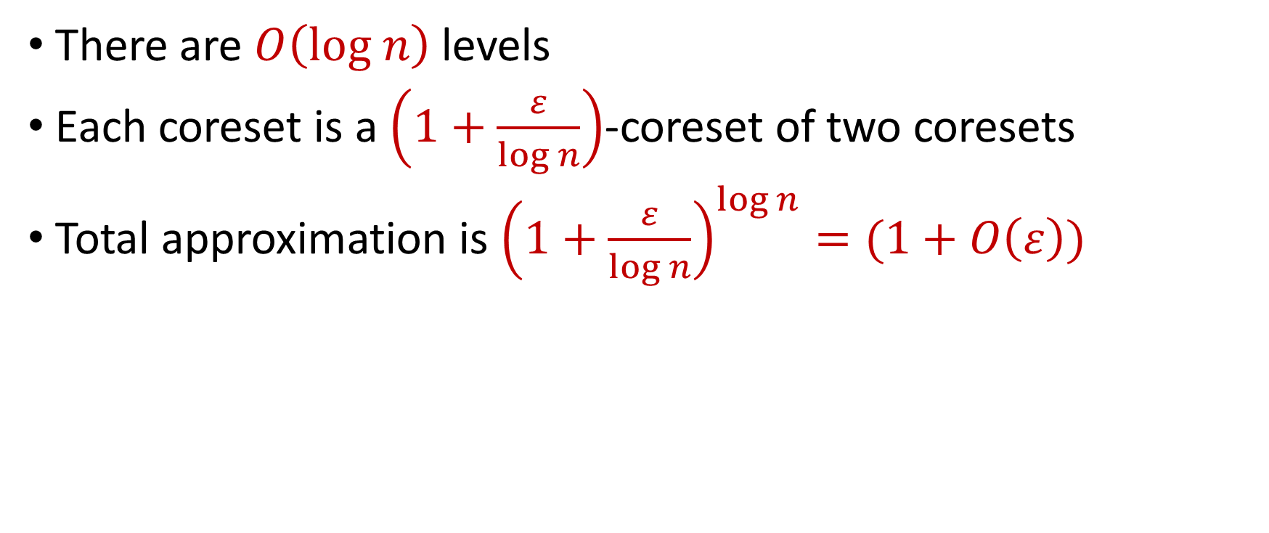
Last Time: $(k,z)$-Clustering in the Streaming Model
There are $O\left(log n\right)$ levels
Each coreset is a $\left(1+\frac{ε}{\log{n}}\right)$-coreset of two coresets
Total approximation is ${\left(1+\frac{ε}{\log{n}}\right)}^{\log{n}}=(1+O\left(ε\right))$

Slide 10

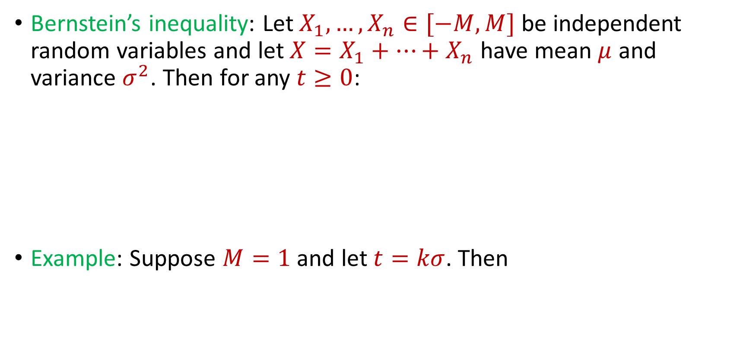
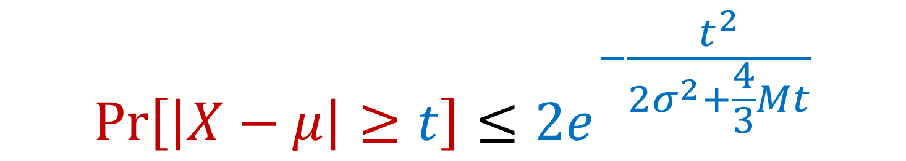
Previously: Bernstein’s Inequality
Bernstein’s inequality: Let $X_{1},…,X_{n}∈[−M,M]$ be independent random variables and let ${X=X}_{1}+…+X_{n}$ have mean $μ$ and variance $σ^{2}$. Then for any $t≥0$:
Example: Suppose $M=1$ and let $t=kσ$. Then
$$Pr\left[\left|X−μ\right|≥t\right]≤2e^{−\frac{t^{2}}{2σ^{2}+\frac{4}{3}Mt}}$$
$$Pr\left[\left|X−μ\right|≥kσ\right]≤2exp\left(−\frac{k^{2}}{4}\right)$$

Slide 11
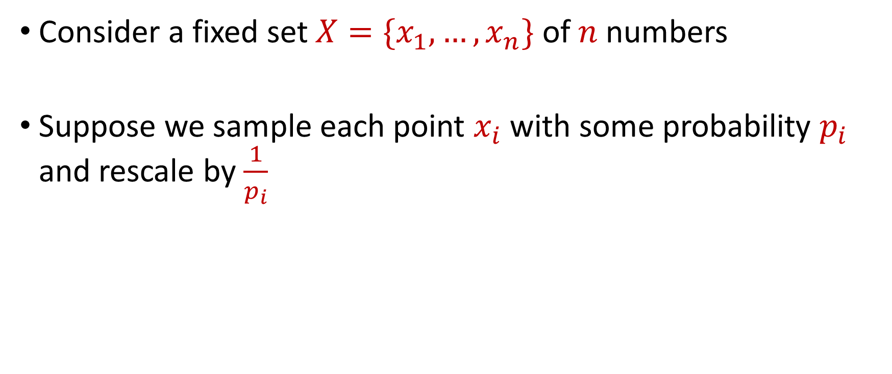
Sampling for Sum Estimation
Consider a fixed set $X=\{x_{1},…,x_{n}\}$ of $n$ numbers
Suppose we sample each point $x_{i}$ with some probability $p_{i}$ and rescale by $\frac{1}{p_{i}}$

Slide 12
1 9 21 11 84 20 92 66 64 2 72 35 39 26

Slide 13
1 9 21 11 84 20 92 66 64 2 72 35 39 26
1
33
184
192
70

Slide 14
1 9 21 11 84 20 92 66 64 2 72 35 39 26
1
33
184
192
70
Goal: Want the sum of the rescaled sampled numbers to approximate the original sum

Slide 15
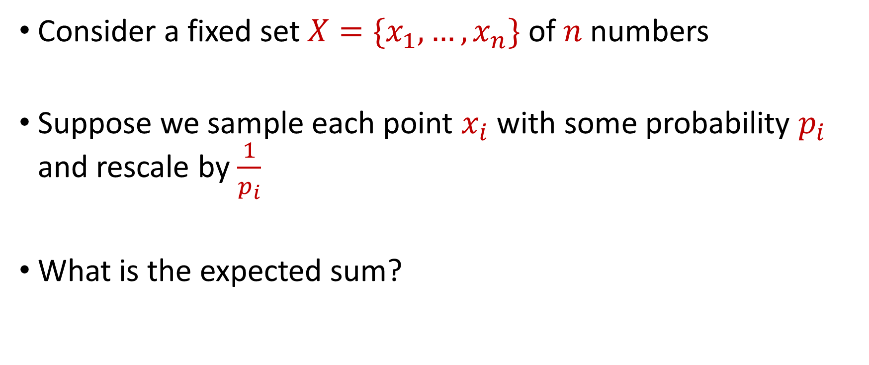
Sampling for Sum Estimation
Consider a fixed set $X=\{x_{1},…,x_{n}\}$ of $n$ numbers
Suppose we sample each point $x_{i}$ with some probability $p_{i}$ and rescale by $\frac{1}{p_{i}}$
What is the expected sum?

Slide 16
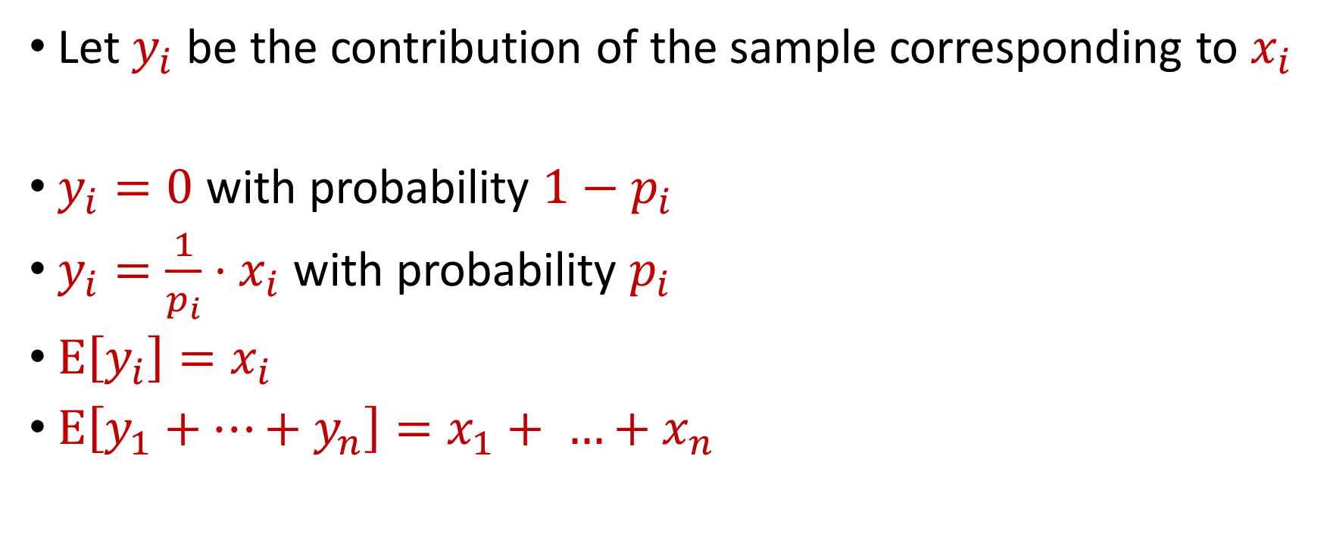
Sampling for Sum Estimation
Let $y_{i}$ be the contribution of the sample corresponding to $x_{i}$
$y_{i}=0$ with probability $1−p_{i}$
$y_{i}=\frac{1}{p_{i}}⋅x_{i}$ with probability $p_{i}$
$E\left[y_{i}\right]=x_{i}$
$E\left[y_{1}+…+y_{n}\right]=x_{1}+ …+x_{n}$

Slide 17
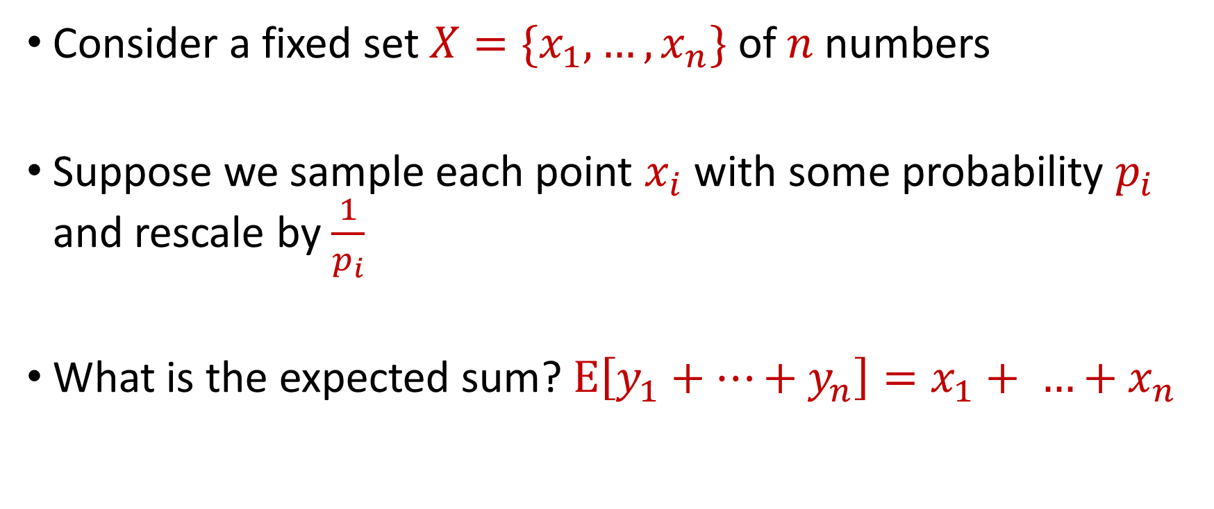
Sampling for Sum Estimation
Consider a fixed set $X=\{x_{1},…,x_{n}\}$ of $n$ numbers
Suppose we sample each point $x_{i}$ with some probability $p_{i}$ and rescale by $\frac{1}{p_{i}}$
What is the expected sum? $E\left[y_{1}+…+y_{n}\right]=x_{1}+ …+x_{n}$

Slide 18
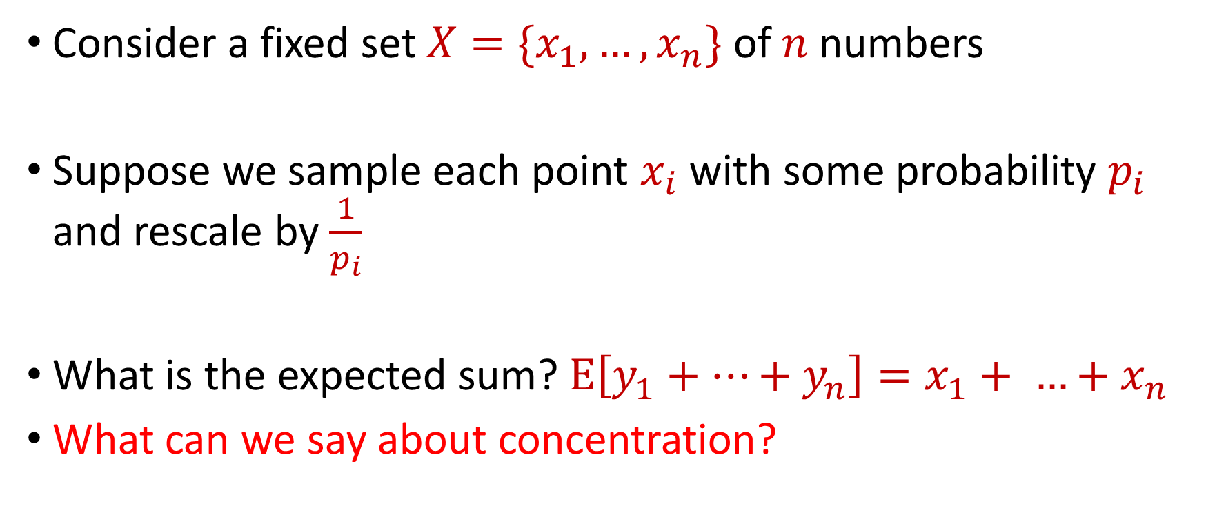
Sampling for Sum Estimation
Consider a fixed set $X=\{x_{1},…,x_{n}\}$ of $n$ numbers
Suppose we sample each point $x_{i}$ with some probability $p_{i}$ and rescale by $\frac{1}{p_{i}}$
What is the expected sum? $E\left[y_{1}+…+y_{n}\right]=x_{1}+ …+x_{n}$
What can we say about concentration?

Slide 19
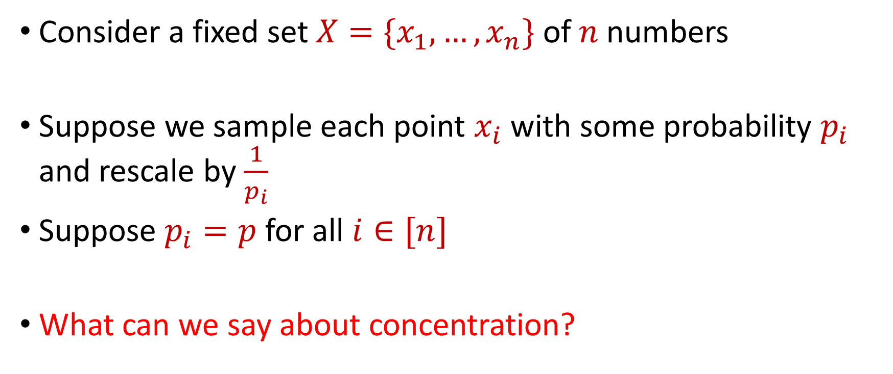
Uniform Sampling for Sum Estimation
Consider a fixed set $X=\{x_{1},…,x_{n}\}$ of $n$ numbers
Suppose we sample each point $x_{i}$ with some probability $p_{i}$ and rescale by $\frac{1}{p_{i}}$
Suppose $p_{i}=p$ for all $i∈[n]$
What can we say about concentration?

Slide 20
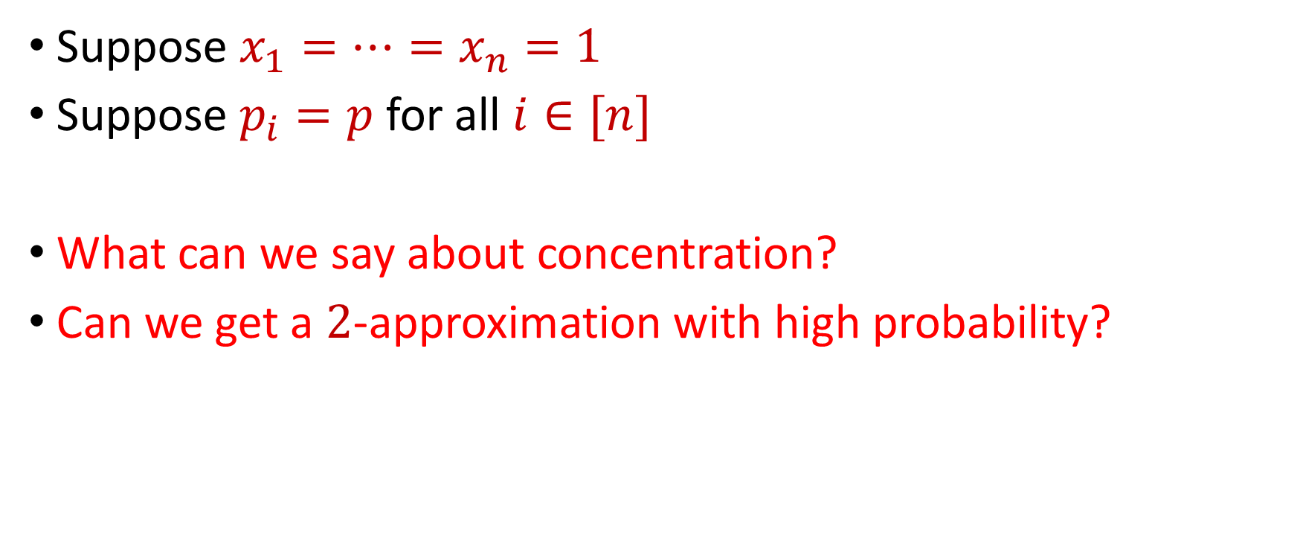
Uniform Sampling for Sum Estimation
Suppose $x_{1}=…=x_{n}=1$
Suppose $p_{i}=p$ for all $i∈[n]$
What can we say about concentration?
Can we get a $2$-approximation with high probability?
1 1 1 1 1 1 1 1 1 1 1 1 1 1 1 1 1 1 1 1 1 1

Slide 21
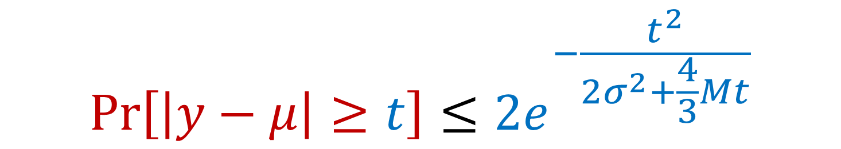
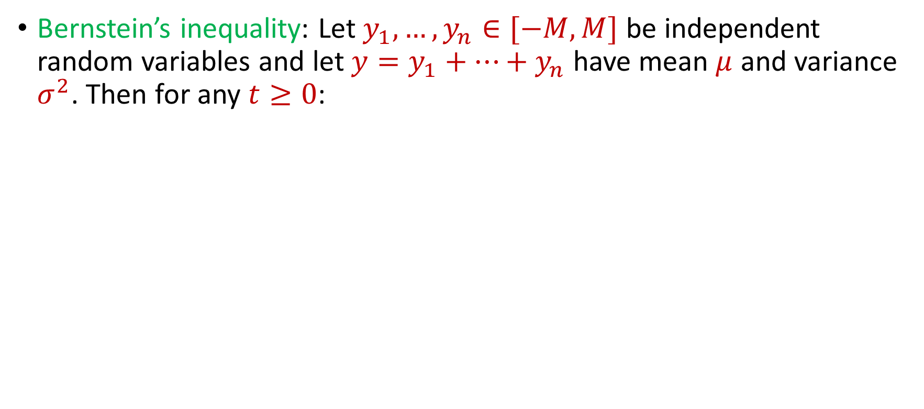
Uniform Sampling for Sum Estimation
Bernstein’s inequality: Let $y_{1},…,y_{n}∈[−M,M]$ be independent random variables and let ${y=y}_{1}+…+y_{n}$ have mean $μ$ and variance $σ^{2}$. Then for any $t≥0$:
$$Pr\left[\left|y−μ\right|≥t\right]≤2e^{−\frac{t^{2}}{2σ^{2}+\frac{4}{3}Mt}}$$

Slide 22
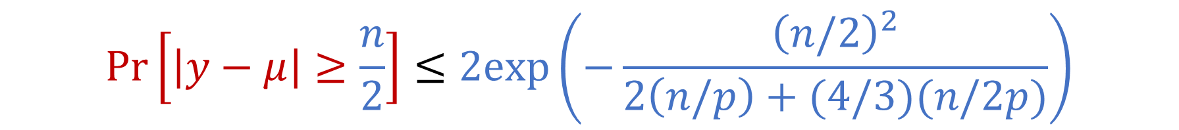
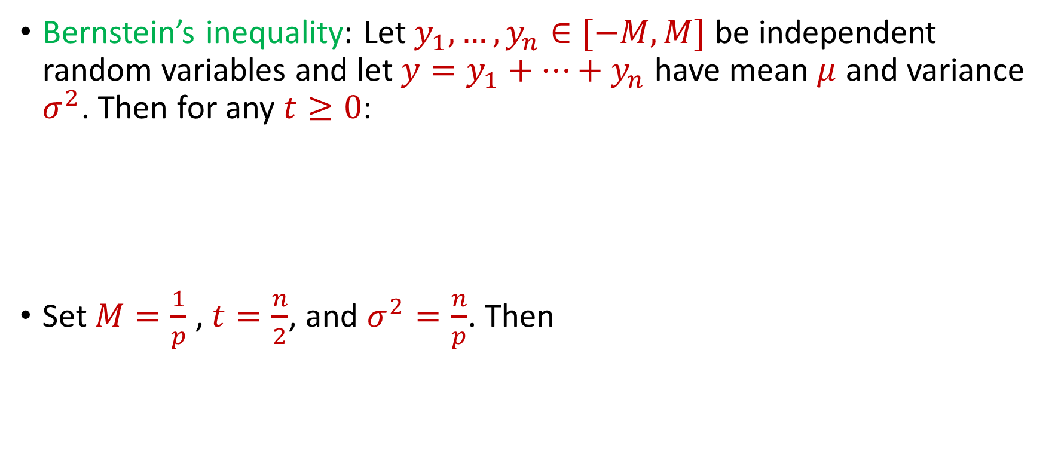
Uniform Sampling for Sum Estimation
Bernstein’s inequality: Let $y_{1},…,y_{n}∈[−M,M]$ be independent random variables and let ${y=y}_{1}+…+y_{n}$ have mean $μ$ and variance $σ^{2}$. Then for any $t≥0$:
Set $M=\frac{1}{p}$ , $t=\frac{n}{2}$, and $σ^{2}=\frac{n}{p}$. Then
$$Pr\left[\left|y−μ\right|≥t\right]≤2e^{−\frac{t^{2}}{2σ^{2}+\frac{4}{3}Mt}}$$
$$Pr\left[\left|y−μ\right|≥\frac{n}{2}\right]≤2exp\left(−\frac{{\left(n/2\right)}^{2}}{2\left(n/p\right)+(4/3)(n/2p)}\right)$$

Slide 23
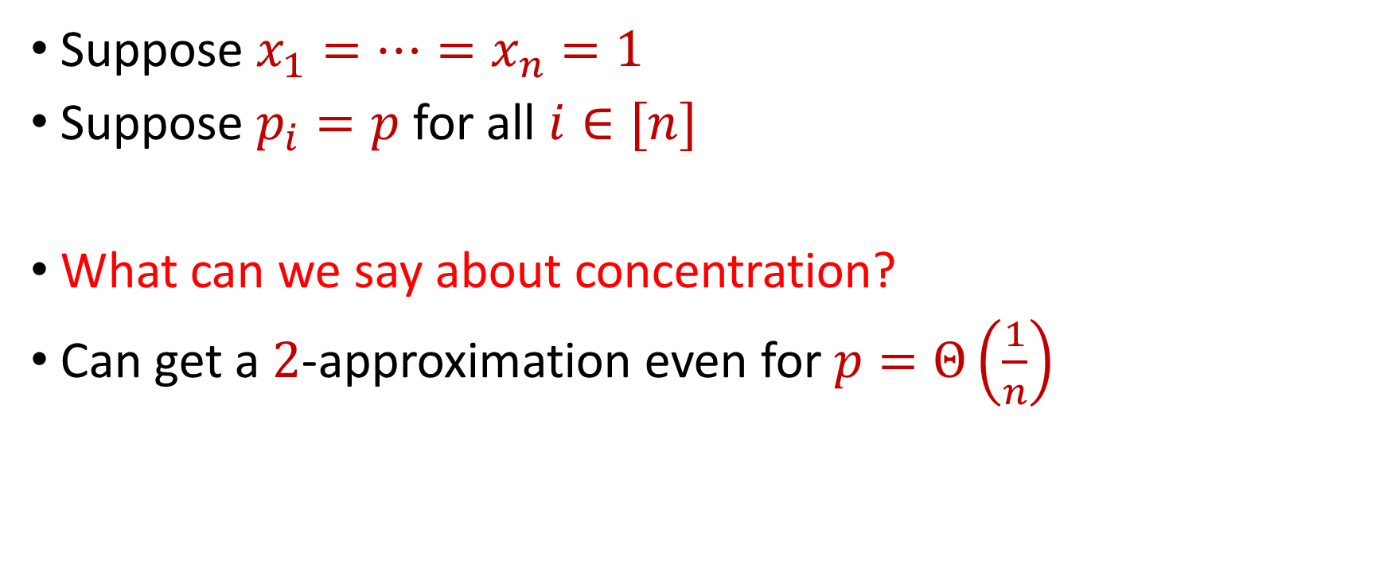
Uniform Sampling for Sum Estimation
Suppose $x_{1}=…=x_{n}=1$
Suppose $p_{i}=p$ for all $i∈[n]$
What can we say about concentration?
Can get a $2$-approximation even for $p=Θ\left(\frac{1}{n}\right)$

Slide 24
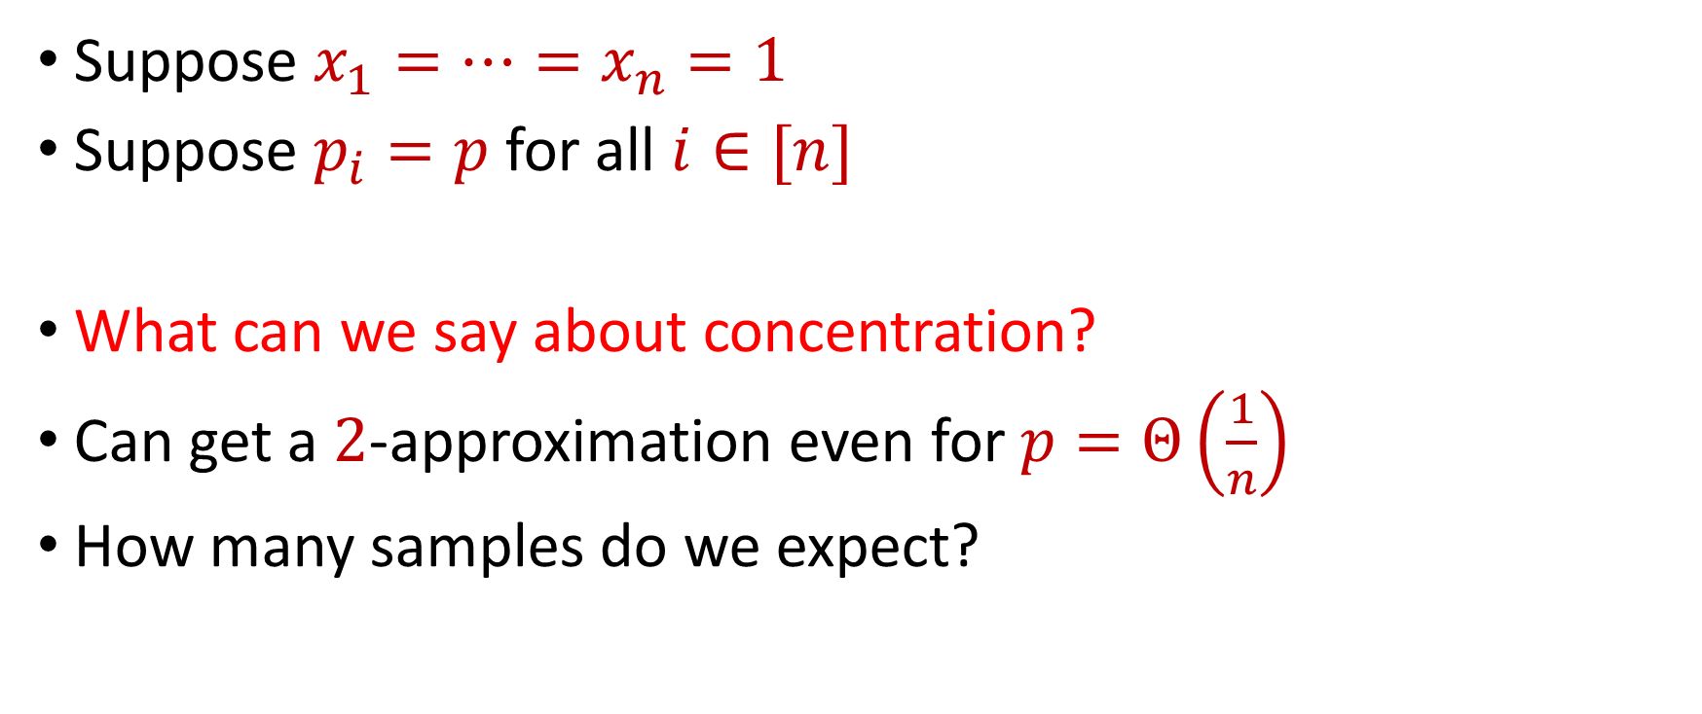
Uniform Sampling for Sum Estimation
Suppose $x_{1}=…=x_{n}=1$
Suppose $p_{i}=p$ for all $i∈[n]$
What can we say about concentration?
Can get a $2$-approximation even for $p=Θ\left(\frac{1}{n}\right)$
How many samples do we expect?

Slide 25
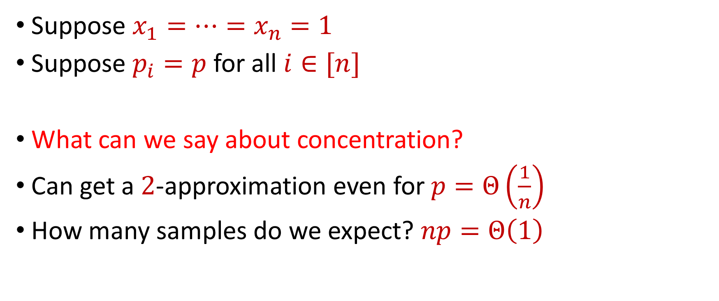
Uniform Sampling for Sum Estimation
Suppose $x_{1}=…=x_{n}=1$
Suppose $p_{i}=p$ for all $i∈[n]$
What can we say about concentration?
Can get a $2$-approximation even for $p=Θ\left(\frac{1}{n}\right)$
How many samples do we expect? $np=Θ\left(1\right)$

Slide 26
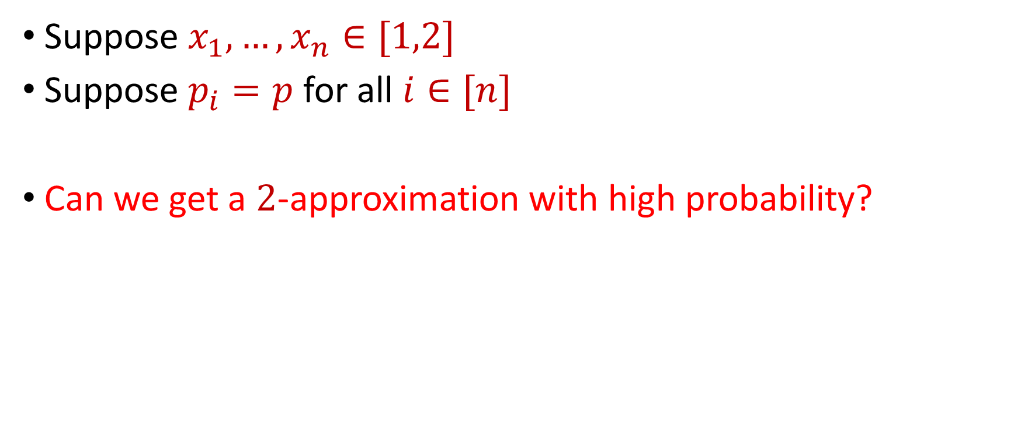
Uniform Sampling for Sum Estimation
Suppose $x_{1},…,x_{n}∈[1,2]$
Suppose $p_{i}=p$ for all $i∈[n]$
Can we get a $2$-approximation with high probability?
1 1 2 1 1 1 1 1 2 1 1 2 1 1 2 1 1 2 1 1 1 1

Slide 27


Uniform Sampling for Sum Estimation
Bernstein’s inequality: Let $y_{1},…,y_{n}∈[−M,M]$ be independent random variables and let ${y=y}_{1}+…+y_{n}$ have mean $μ$ and variance $σ^{2}$. Then for any $t≥0$:
Set $M=\frac{2}{p}$ , $t=\frac{x}{2}$, and $σ^{2}≈\frac{4n}{p}$. Then
$$Pr\left[\left|y−μ\right|≥t\right]≤2e^{−\frac{t^{2}}{2σ^{2}+\frac{4}{3}Mt}}$$
$$Pr\left[\left|y−μ\right|≥\frac{x}{2}\right]≤2exp\left(−\frac{{\left(x/2\right)}^{2}}{2\left(4n/p\right)+(4/3)(x/p)}\right)$$

Slide 28
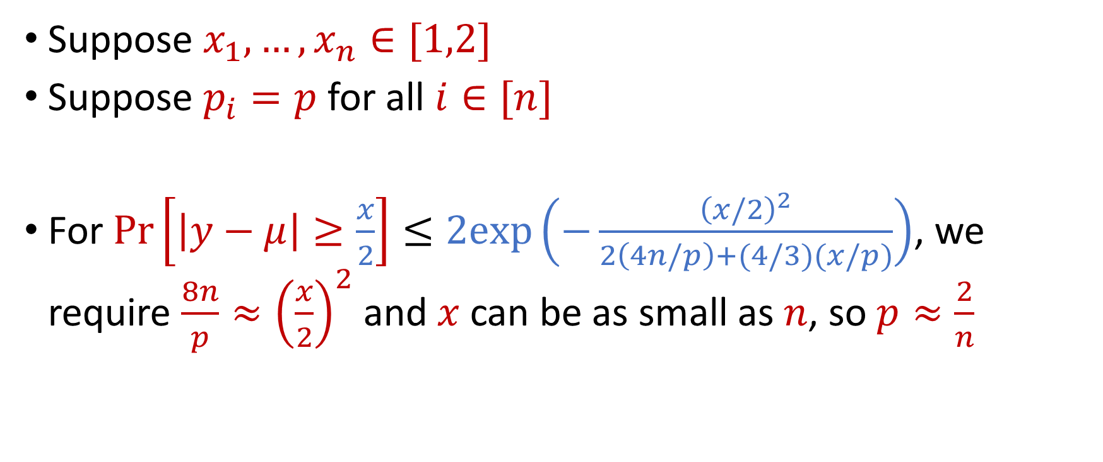
Uniform Sampling for Sum Estimation
Suppose $x_{1},…,x_{n}∈[1,2]$
Suppose $p_{i}=p$ for all $i∈[n]$
For $Pr\left[\left|y−μ\right|≥\frac{x}{2}\right]≤2exp\left(−\frac{{\left(x/2\right)}^{2}}{2\left(4n/p\right)+(4/3)(x/p)}\right)$, we require $\frac{8n}{p}≈{\left(\frac{x}{2}\right)}^{2}$ and $x$ can be as small as $n$, so $p≈\frac{2}{n}$

Slide 29
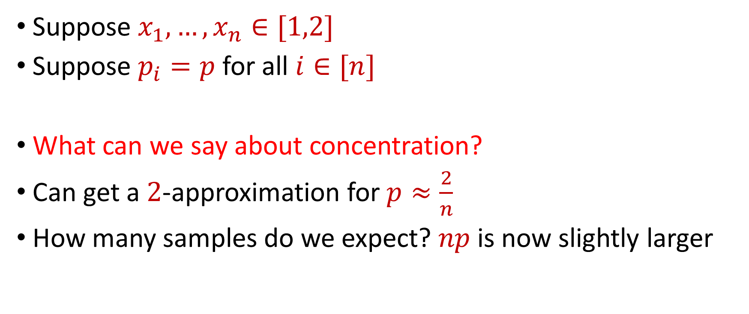
Uniform Sampling for Sum Estimation
Suppose $x_{1},…,x_{n}∈[1,2]$
Suppose $p_{i}=p$ for all $i∈[n]$
What can we say about concentration?
Can get a $2$-approximation for $p≈\frac{2}{n}$
How many samples do we expect? $np$ is now slightly larger

Slide 30
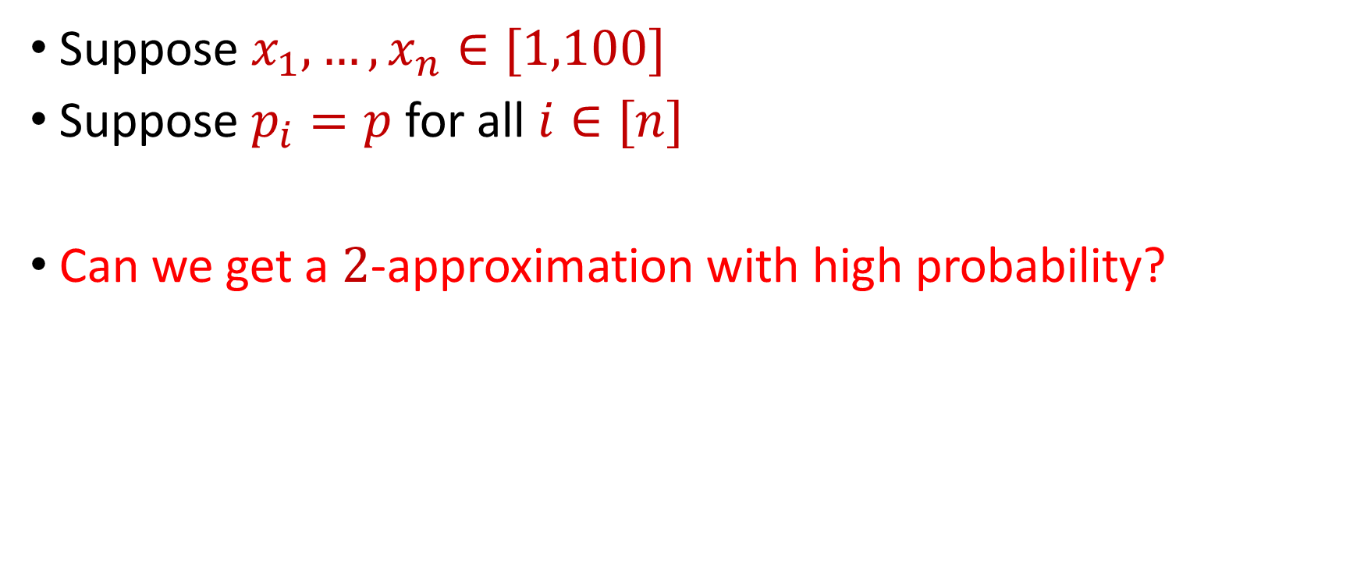
Uniform Sampling for Sum Estimation
Suppose $x_{1},…,x_{n}∈[1,100]$
Suppose $p_{i}=p$ for all $i∈[n]$
Can we get a $2$-approximation with high probability?
1 9 21 11 84 20 92 66 64 2 72 35 39 26

Slide 31
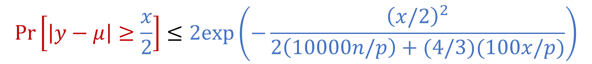
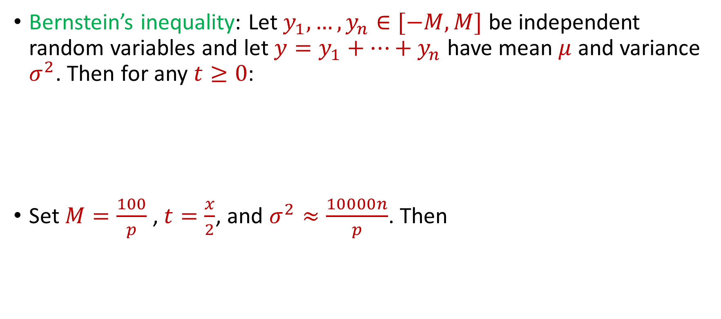
Uniform Sampling for Sum Estimation
Bernstein’s inequality: Let $y_{1},…,y_{n}∈[−M,M]$ be independent random variables and let ${y=y}_{1}+…+y_{n}$ have mean $μ$ and variance $σ^{2}$. Then for any $t≥0$:
Set $M=\frac{100}{p}$ , $t=\frac{x}{2}$, and $σ^{2}≈\frac{10000n}{p}$. Then
$$Pr\left[\left|y−μ\right|≥t\right]≤2e^{−\frac{t^{2}}{2σ^{2}+\frac{4}{3}Mt}}$$
$$Pr\left[\left|y−μ\right|≥\frac{x}{2}\right]≤2exp\left(−\frac{{\left(x/2\right)}^{2}}{2\left(10000n/p\right)+(4/3)(100x/p)}\right)$$

Slide 32
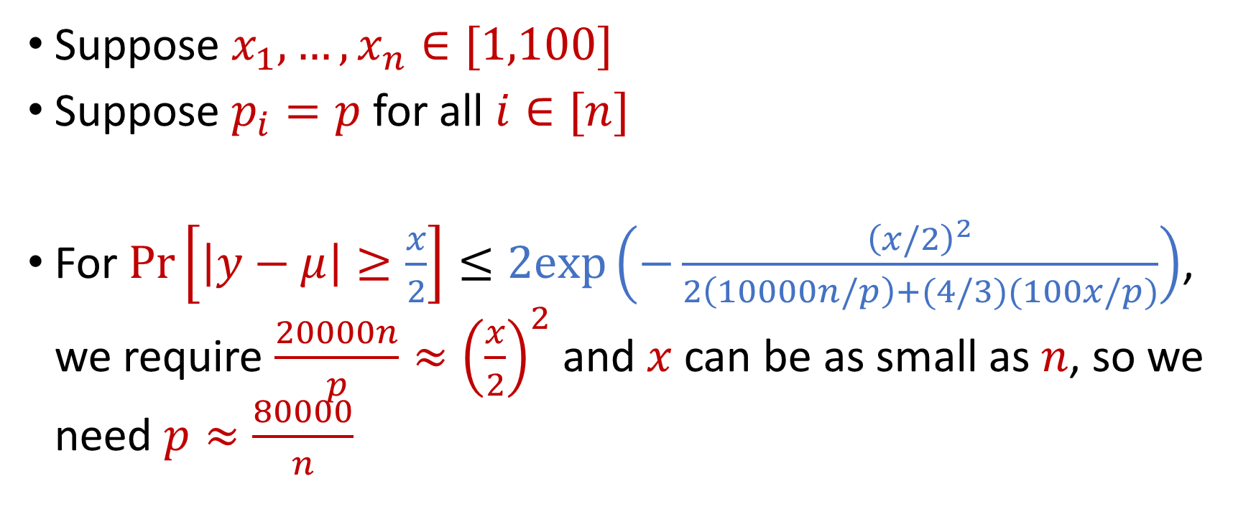
Uniform Sampling for Sum Estimation
Suppose $x_{1},…,x_{n}∈[1,100]$
Suppose $p_{i}=p$ for all $i∈[n]$
For $Pr\left[\left|y−μ\right|≥\frac{x}{2}\right]≤2exp\left(−\frac{{\left(x/2\right)}^{2}}{2\left(10000n/p\right)+(4/3)(100x/p)}\right)$, we require $\frac{20000n}{p}≈{\left(\frac{x}{2}\right)}^{2}$ and $x$ can be as small as $n$, so we need $p≈\frac{80000}{n}$

Slide 33
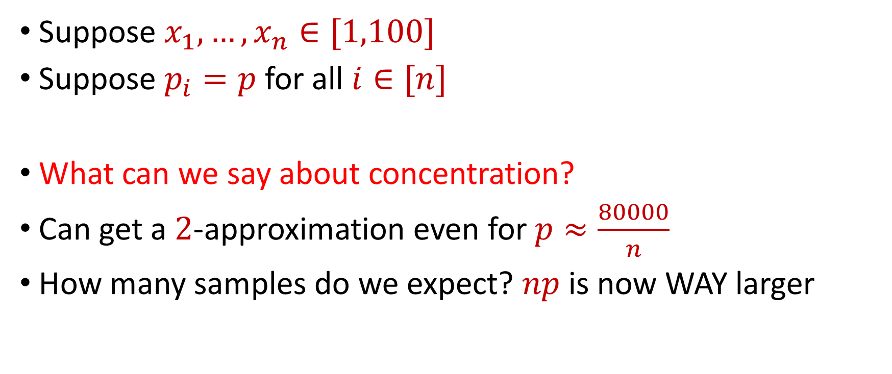
Uniform Sampling for Sum Estimation
Suppose $x_{1},…,x_{n}∈[1,100]$
Suppose $p_{i}=p$ for all $i∈[n]$
What can we say about concentration?
Can get a $2$-approximation even for $p≈\frac{80000}{n}$
How many samples do we expect? $np$ is now WAY larger

Slide 34

Uniform Sampling for Sum Estimation
Suppose $x_{1},…,x_{n}∈[1,n]$
Suppose $p_{i}=p$ for all $i∈[n]$
Can we get a $2$-approximation with high probability?

Slide 35


Uniform Sampling for Sum Estimation
Bernstein’s inequality: Let $y_{1},…,y_{n}∈[−M,M]$ be independent random variables and let ${y=y}_{1}+…+y_{n}$ have mean $μ$ and variance $σ^{2}$. Then for any $t≥0$:
Set $M=\frac{n}{p}$ , $t=\frac{x}{2}$, and $σ^{2}≈\frac{n^{2}}{p}$. Then
$$Pr\left[\left|y−μ\right|≥t\right]≤2e^{−\frac{t^{2}}{2σ^{2}+\frac{4}{3}Mt}}$$
$$Pr\left[\left|y−μ\right|≥\frac{x}{2}\right]≤2exp\left(−\frac{{\left(x/2\right)}^{2}}{2\left(n^{2}/p\right)+(4/3)(nx/2p)}\right)$$

Slide 36
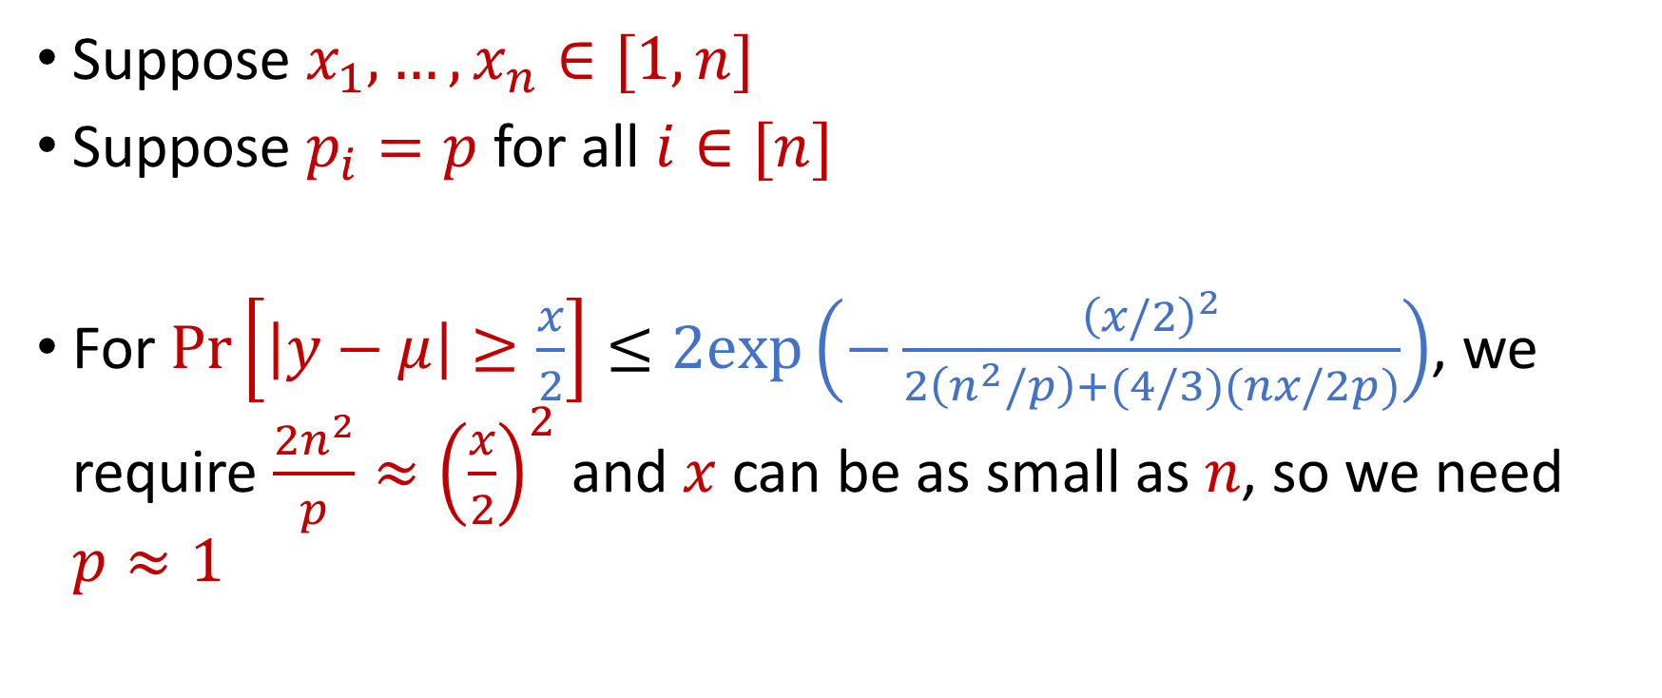
Uniform Sampling for Sum Estimation
Suppose $x_{1},…,x_{n}∈[1,n]$
Suppose $p_{i}=p$ for all $i∈[n]$
For $Pr\left[\left|y−μ\right|≥\frac{x}{2}\right]≤2exp\left(−\frac{{\left(x/2\right)}^{2}}{2\left(n^{2}/p\right)+(4/3)(nx/2p)}\right)$, we require $\frac{2n^{2}}{p}≈{\left(\frac{x}{2}\right)}^{2}$ and $x$ can be as small as $n$, so we need $p≈1$

Slide 37
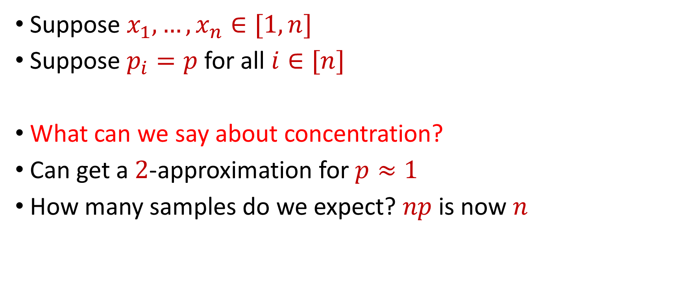
Uniform Sampling for Sum Estimation
Suppose $x_{1},…,x_{n}∈[1,n]$
Suppose $p_{i}=p$ for all $i∈[n]$
What can we say about concentration?
Can get a $2$-approximation for $p≈1$
How many samples do we expect? $np$ is now $n$

Slide 38
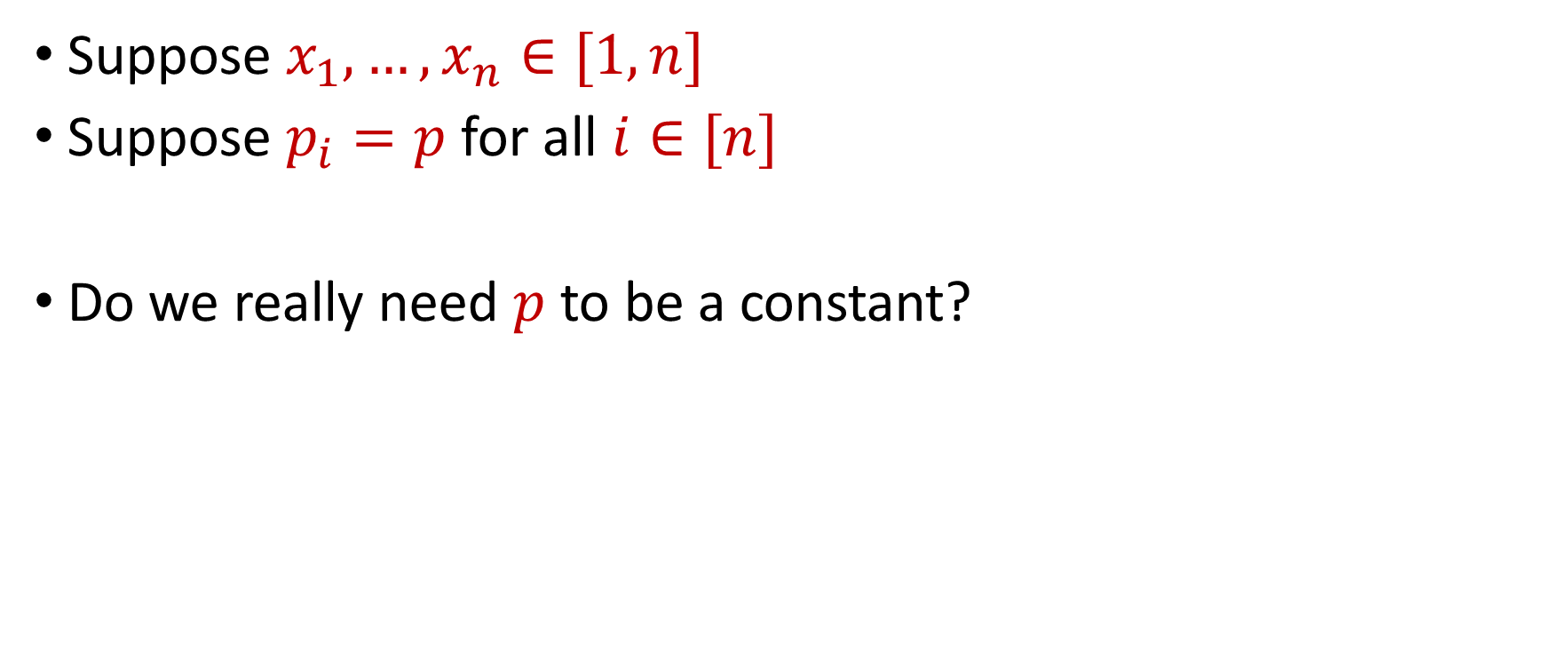
Uniform Sampling for Sum Estimation
Suppose $x_{1},…,x_{n}∈[1,n]$
Suppose $p_{i}=p$ for all $i∈[n]$
Do we really need $p$ to be a constant?

Slide 39
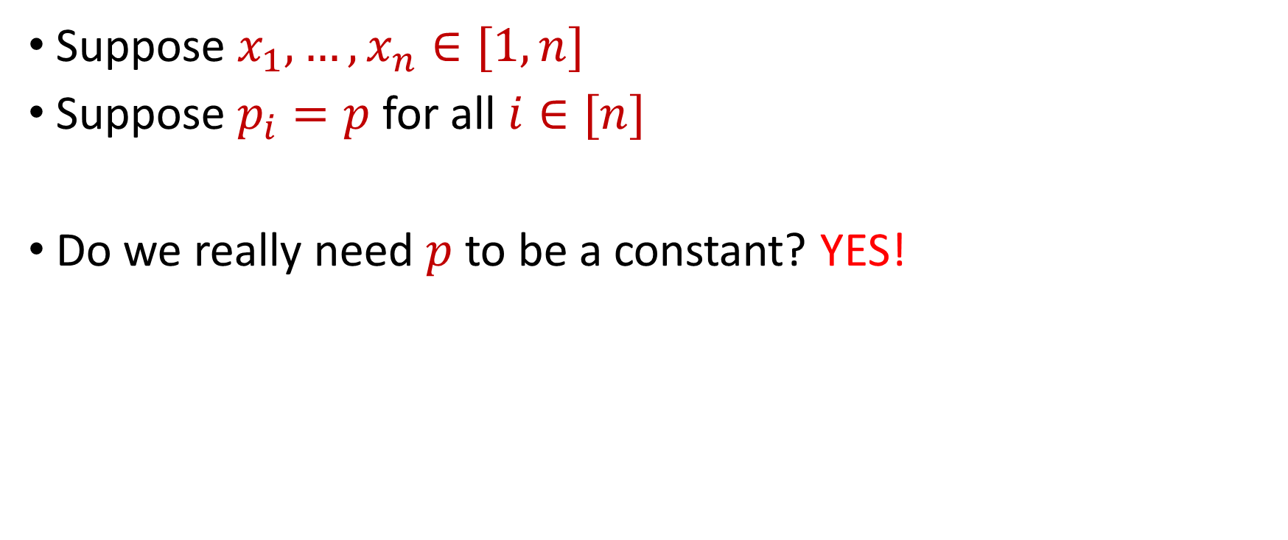
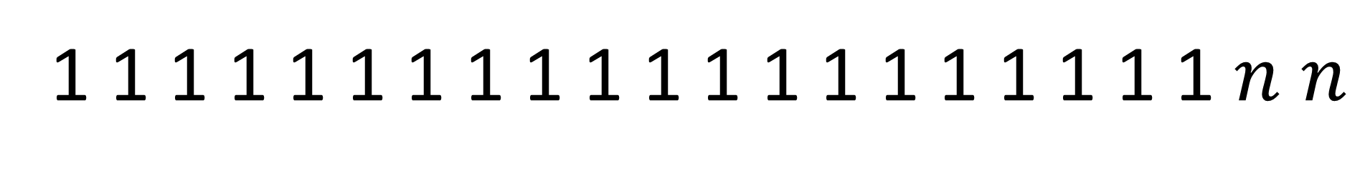
Uniform Sampling for Sum Estimation
Suppose $x_{1},…,x_{n}∈[1,n]$
Suppose $p_{i}=p$ for all $i∈[n]$
Do we really need $p$ to be a constant? YES!
1 1 1 1 1 1 1 1 1 1 1 1 1 1 1 1 1 1 1 1 $n$ $n$

Slide 40
Sampling for Sum Estimation
Consider a fixed set $X=\{x_{1},…,x_{n}\}$ of $n$ numbers
Suppose we sample each point $x_{i}$ with some probability $p_{i}$ and rescale by $\frac{1}{p_{i}}$
What is the expected sum? $E\left[y_{1}+…+y_{n}\right]=x_{1}+ …+x_{n}$
What can we say about concentration?

Slide 41
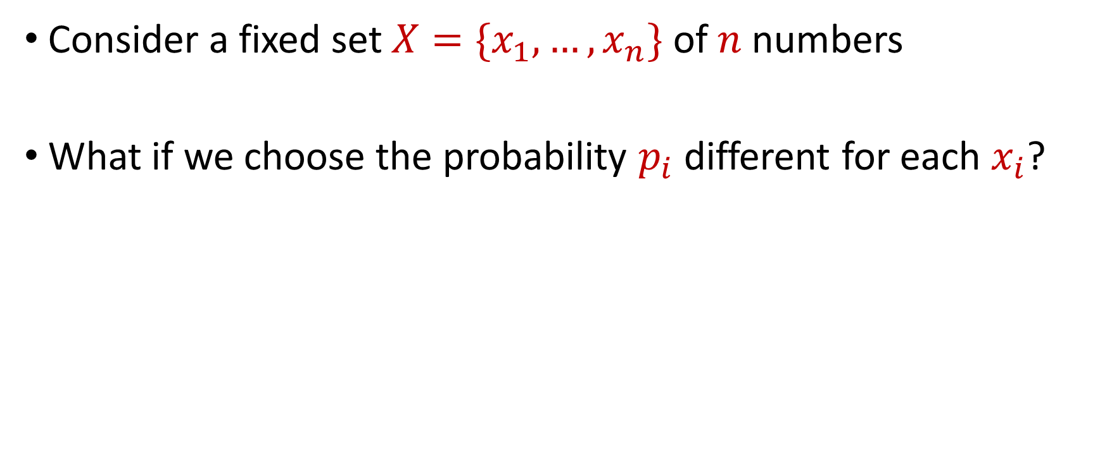
Sampling for Sum Estimation
Consider a fixed set $X=\{x_{1},…,x_{n}\}$ of $n$ numbers
What if we choose the probability $p_{i}$ different for each $x_{i}$?

Slide 42
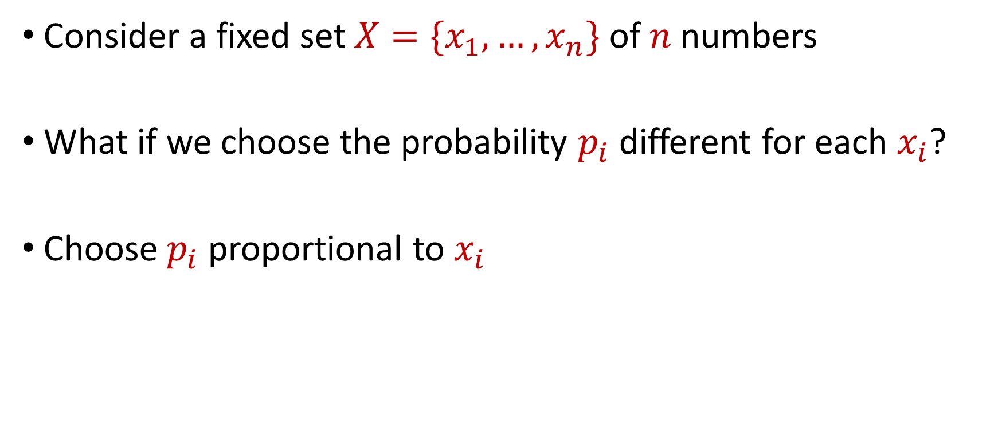
Sampling for Sum Estimation
Consider a fixed set $X=\{x_{1},…,x_{n}\}$ of $n$ numbers
What if we choose the probability $p_{i}$ different for each $x_{i}$?
Choose $p_{i}$ proportional to $x_{i}$

Slide 43
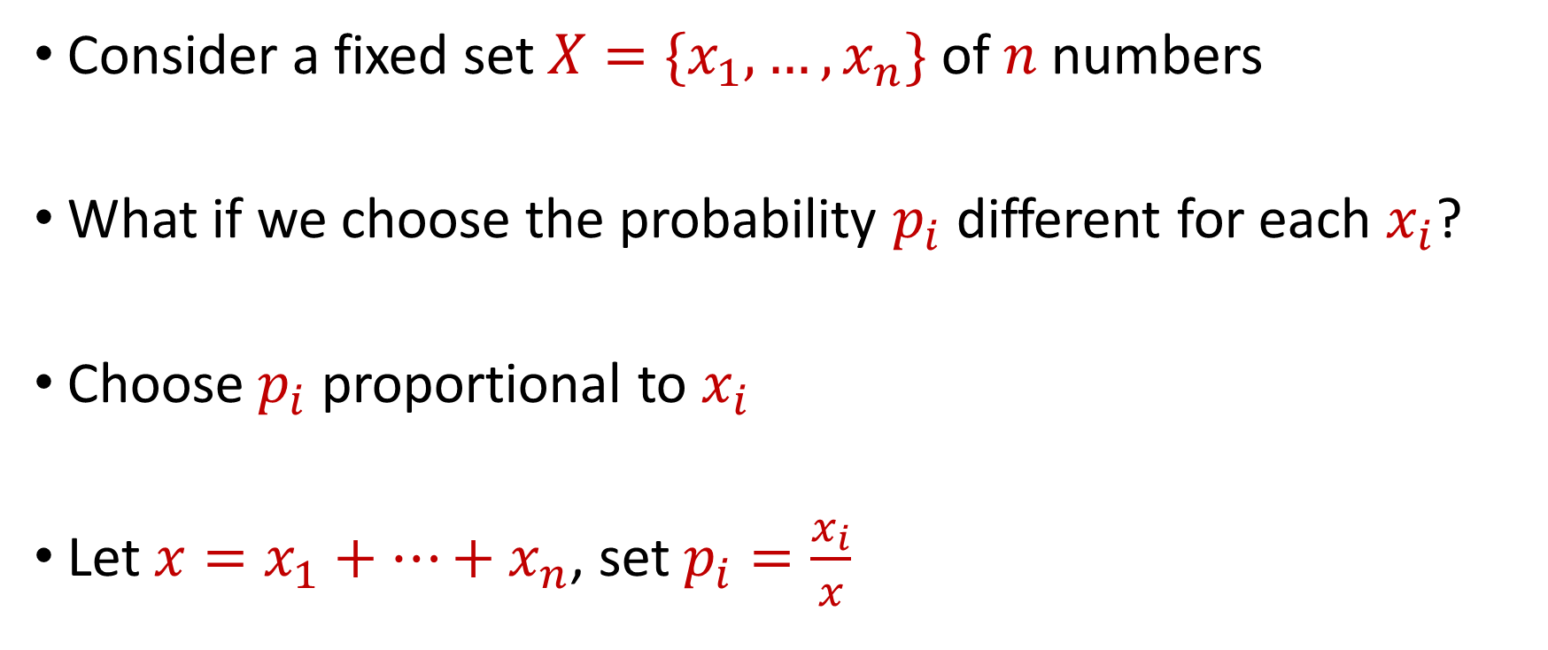
Importance Sampling for Sum Estimation
Consider a fixed set $X=\{x_{1},…,x_{n}\}$ of $n$ numbers
What if we choose the probability $p_{i}$ different for each $x_{i}$?
Choose $p_{i}$ proportional to $x_{i}$
Let $x=x_{1}+…+x_{n}$, set $p_{i}=\frac{x_{i}}{x}$

Slide 44
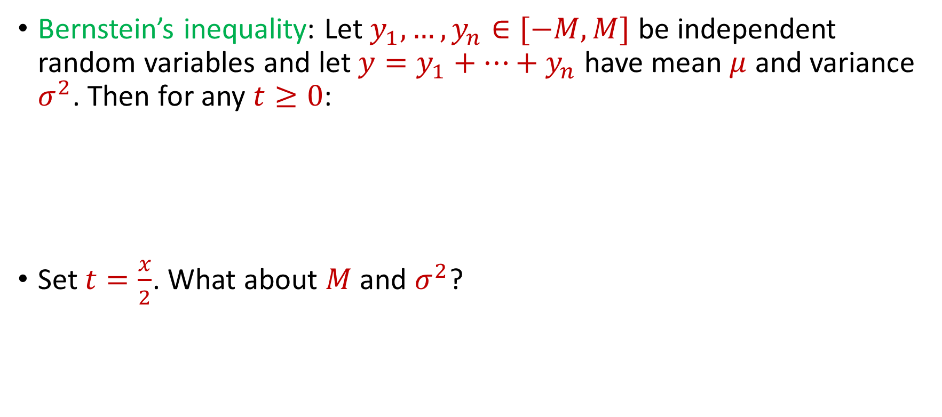
Importance Sampling for Sum Estimation
Bernstein’s inequality: Let $y_{1},…,y_{n}∈[−M,M]$ be independent random variables and let ${y=y}_{1}+…+y_{n}$ have mean $μ$ and variance $σ^{2}$. Then for any $t≥0$:
Set $t=\frac{x}{2}$. What about $M$and $σ^{2}$?
$$Pr\left[\left|y−μ\right|≥t\right]≤2e^{−\frac{t^{2}}{2σ^{2}+\frac{4}{3}Mt}}$$

Slide 45
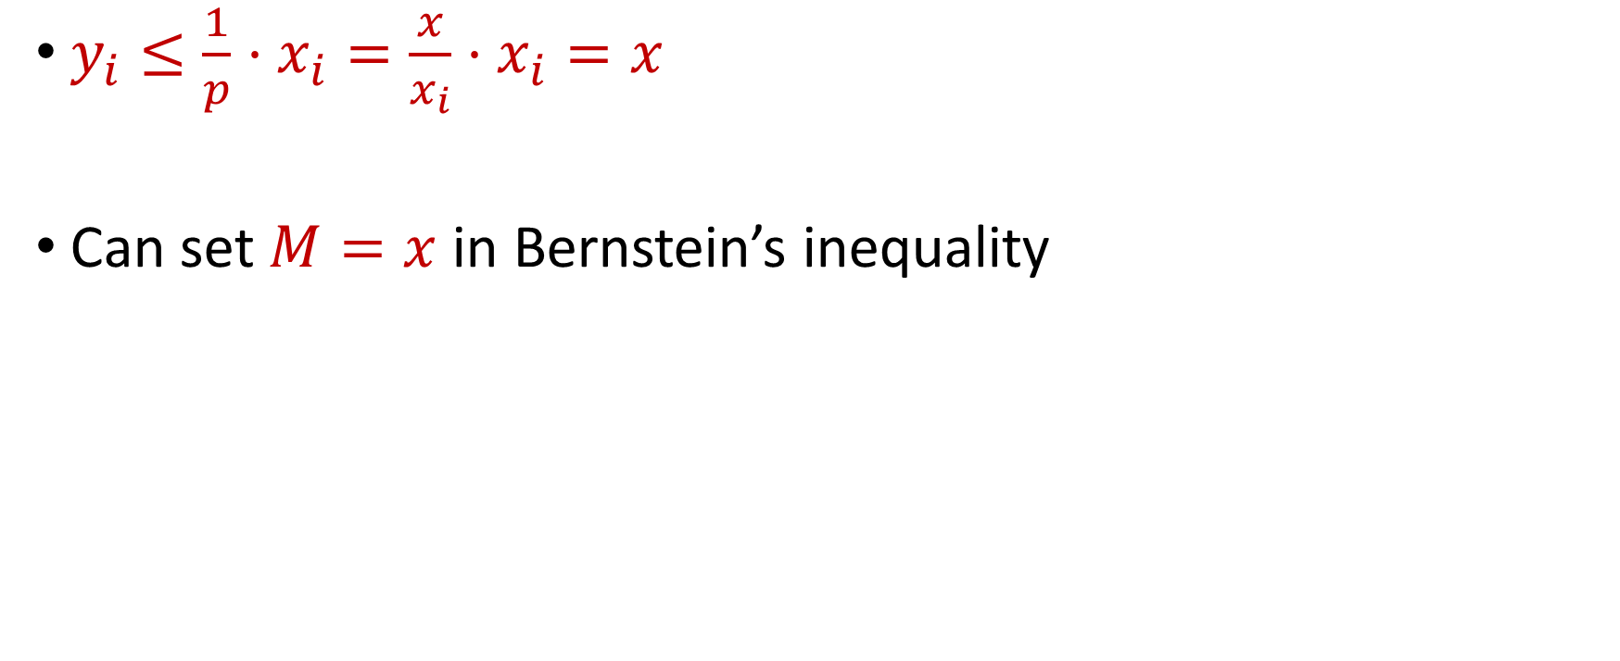
Importance Sampling for Sum Estimation
$y_{i}≤\frac{1}{p}⋅x_{i}=\frac{x}{x_{i}}⋅x_{i}=x$
Can set $M=x$ in Bernstein’s inequality

Slide 46
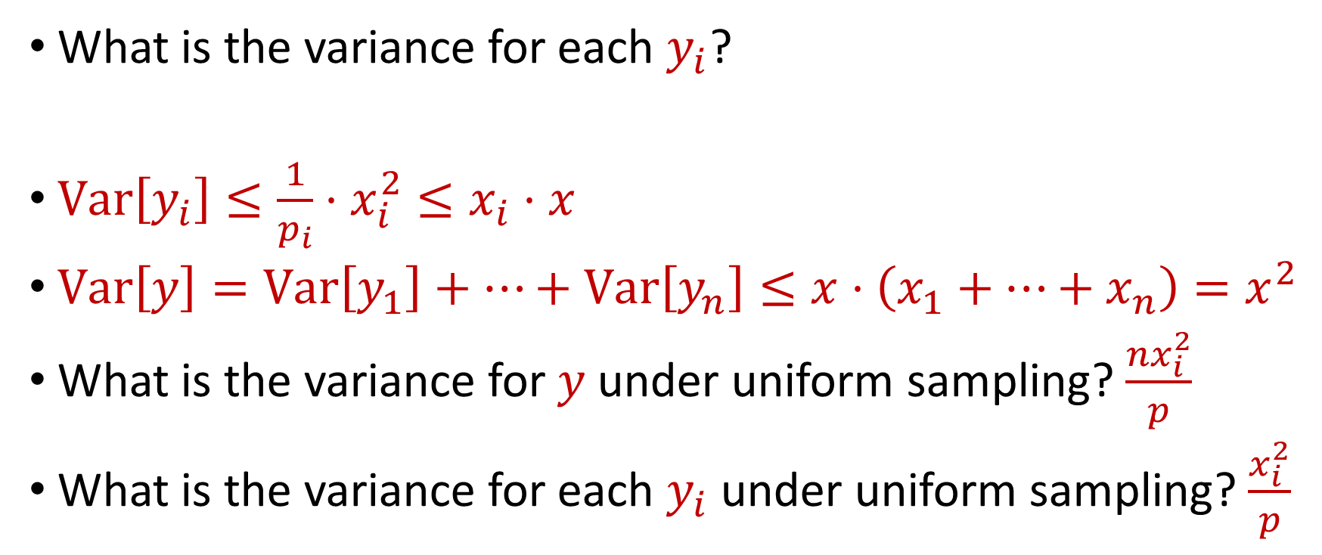
Importance Sampling for Sum Estimation
What is the variance for each $y_{i}$?
$Var\left[y_{i}\right]≤\frac{1}{p_{i}}⋅x_{i}^{2}≤x_{i}⋅x$
$Var\left[y\right]=Var\left[y_{1}\right]+…+Var\left[y_{n}\right]≤x⋅\left(x_{1}+…+x_{n}\right)=x^{2}$
What is the variance for $y$under uniform sampling? $\frac{{nx}_{i}^{2}}{p}$
What is the variance for each $y_{i}$ under uniform sampling? $\frac{x_{i}^{2}}{p}$

Slide 47

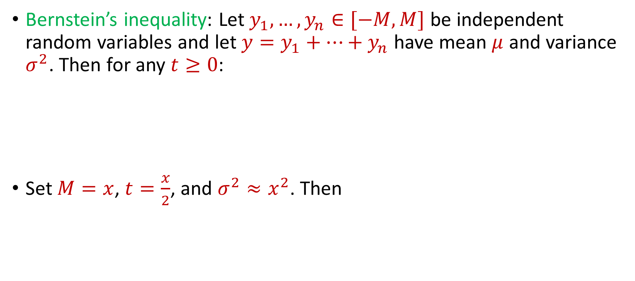
Importance Sampling for Sum Estimation
Bernstein’s inequality: Let $y_{1},…,y_{n}∈[−M,M]$ be independent random variables and let ${y=y}_{1}+…+y_{n}$ have mean $μ$ and variance $σ^{2}$. Then for any $t≥0$:
Set $M=x$, $t=\frac{x}{2}$, and $σ^{2}≈x^{2}$. Then
$$Pr\left[\left|y−μ\right|≥t\right]≤2e^{−\frac{t^{2}}{2σ^{2}+\frac{4}{3}Mt}}$$
$$Pr\left[\left|y−μ\right|≥\frac{x}{2}\right]≤2exp\left(−\frac{{\left(x/2\right)}^{2}}{2x^{2}+(4/3)(x^{2}/2)}\right)$$

Slide 48
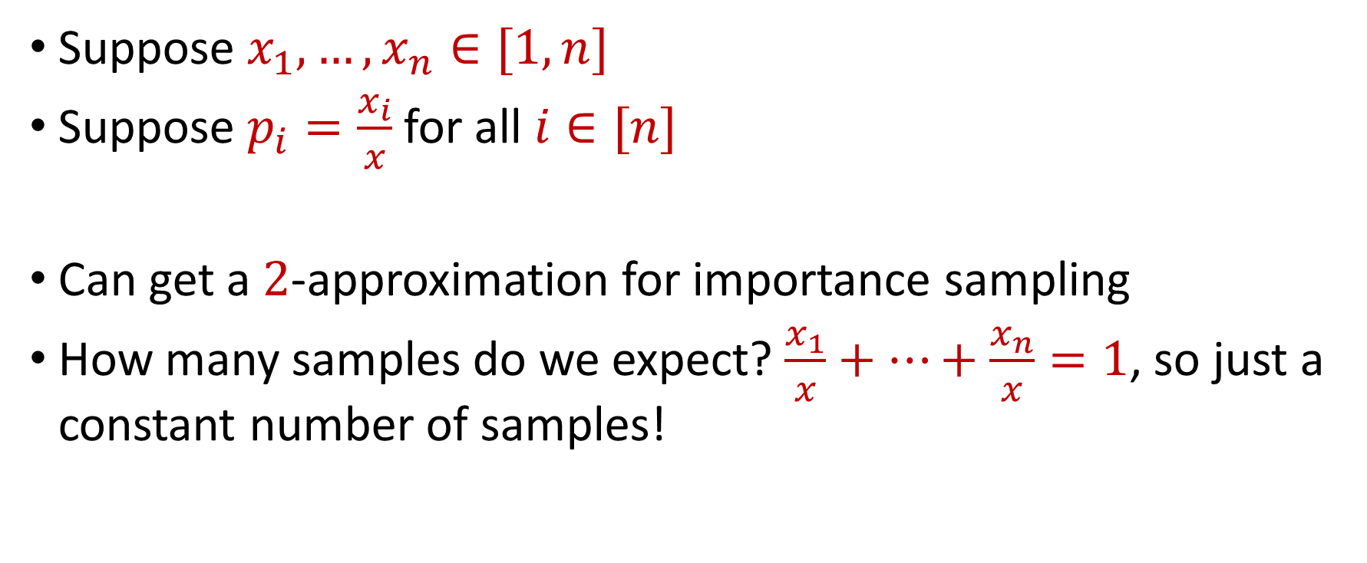
Importance Sampling for Sum Estimation
Suppose $x_{1},…,x_{n}∈[1,n]$
Suppose $p_{i}=\frac{x_{i}}{x}$ for all $i∈[n]$
Can get a $2$-approximation for importance sampling
How many samples do we expect? $\frac{x_{1}}{x}+…+\frac{x_{n}}{x}=1$, so just a constant number of samples!

Slide 49
Coreset Construction and Sampling
Consider a fixed set $X$ and a fixed set $C$ of $k$ centers, which induces a fixed cost $Cost(X,C)$

Slide 50
Coreset Construction and Sampling
Consider a fixed set $X$ and a fixed set $C$ of $k$ centers, which induces a fixed cost $Cost(X,C)$
A simple way to obtain $X′$with $Cost\left(X^{′},C\right)≈Cost(X,C)$ is to uniformly sample points of $X$ into $X′$

Slide 51
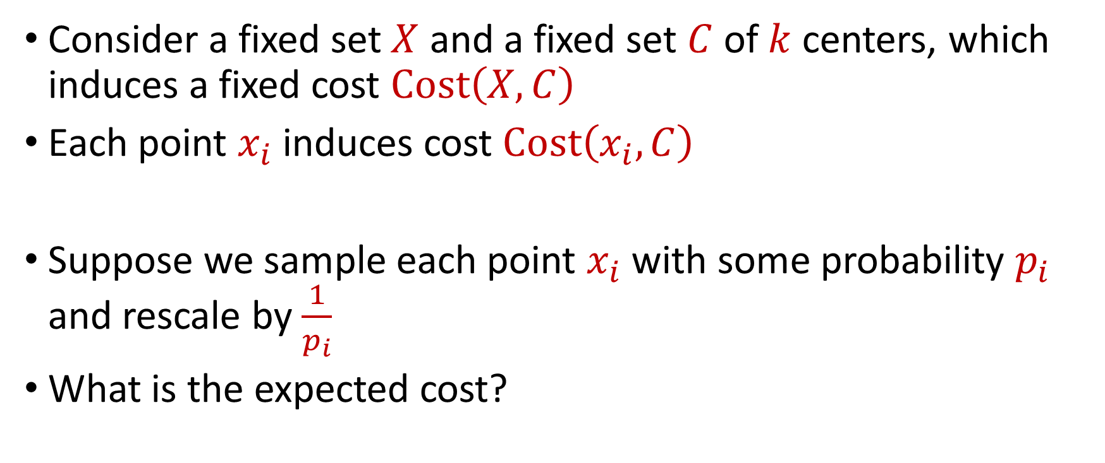
Coreset Construction and Uniform Sampling
Consider a fixed set $X$ and a fixed set $C$ of $k$ centers, which induces a fixed cost $Cost\left(X,C\right)$
Each point $x_{i}$ induces cost $Cost\left(x_{i},C\right)$
Suppose we sample each point $x_{i}$ with some probability $p_{i}$ and rescale by $\frac{1}{p_{i}}$
What is the expected cost?

Slide 52
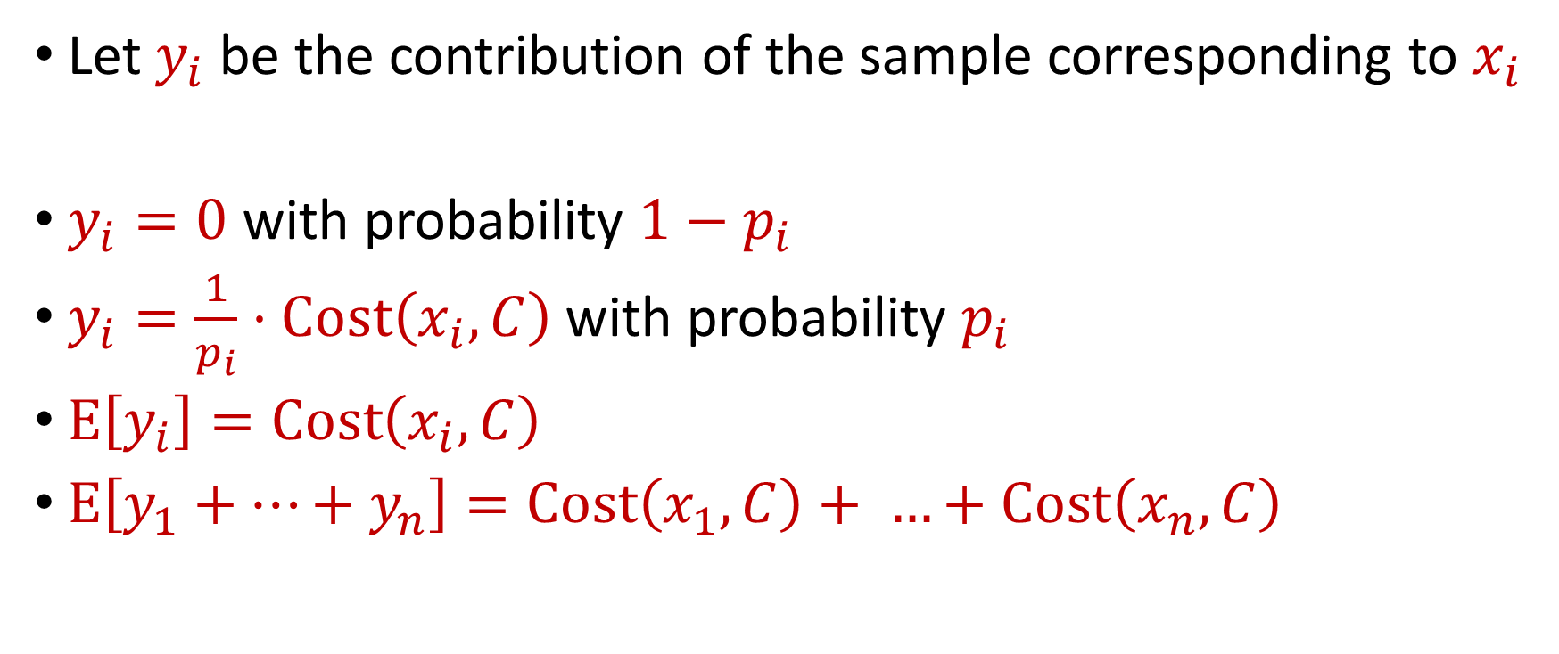
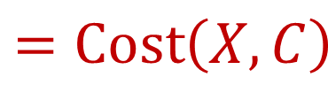
Sampling for Sum Estimation
Let $y_{i}$ be the contribution of the sample corresponding to $x_{i}$
$y_{i}=0$ with probability $1−p_{i}$
$y_{i}=\frac{1}{p_{i}}⋅Cost\left(x_{i},C\right)$ with probability $p_{i}$
$E\left[y_{i}\right]=Cost\left(x_{i},C\right)$
$E\left[y_{1}+…+y_{n}\right]=Cost\left(x_{1},C\right)+ …+Cost\left(x_{n},C\right)$
$$=Cost\left(X,C\right)$$

Slide 53
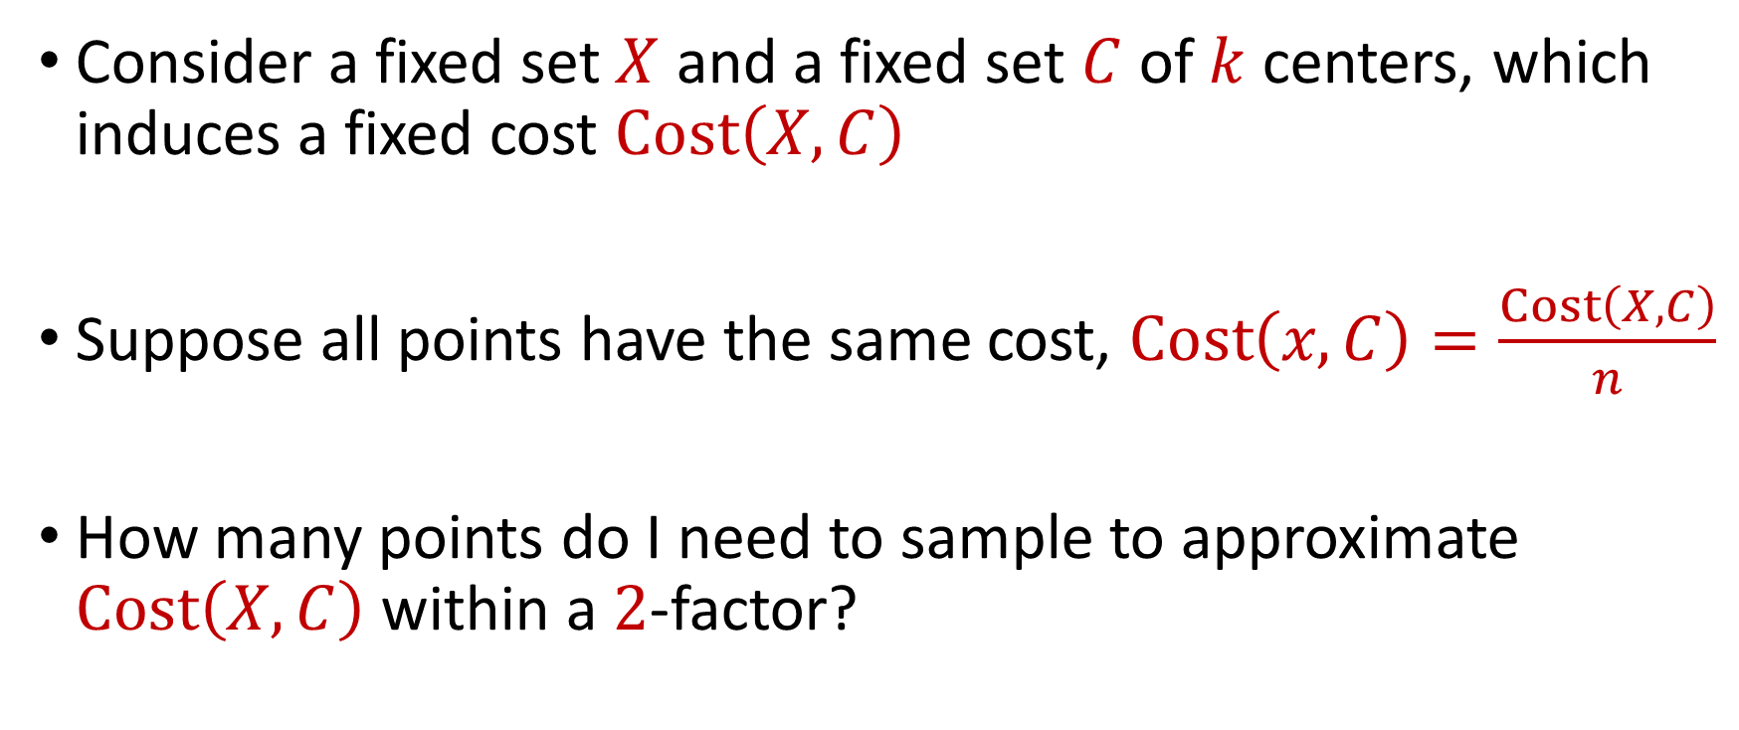
Coreset Construction and Uniform Sampling
Consider a fixed set $X$ and a fixed set $C$ of $k$ centers, which induces a fixed cost $Cost\left(X,C\right)$
Suppose all points have the same cost, $Cost\left(x,C\right)=\frac{Cost\left(X,C\right)}{n}$
How many points do I need to sample to approximate $Cost\left(X,C\right)$ within a $2$-factor?

Slide 54

Bernstein’s Inequality
Bernstein’s inequality: Let $X_{1},…,X_{n}∈[−M,M]$ be independent random variables and let ${X=X}_{1}+…+X_{n}$ have mean $μ$ and variance $σ^{2}$. Then for any $t≥0$:
$$Pr\left[\left|X−μ\right|≥t\right]≤2e^{−\frac{t^{2}}{2σ^{2}+\frac{4}{3}Mt}}$$

Slide 55

Bernstein’s Inequality
Bernstein’s inequality: Let $X_{1},…,X_{n}∈[−M,M]$ be independent random variables and let ${X=X}_{1}+…+X_{n}$ have mean $μ$ and variance $σ^{2}$. Then for any $t≥0$:
Suppose $M=\frac{Cost\left(X,C\right)}{np}$, $t=\frac{1}{2}⋅Cost\left(X,C\right)$, and $σ^{2}=\frac{Cost\left(X,C\right)}{p}$. Then
$$Pr\left[\left|X−μ\right|≥t\right]≤2e^{−\frac{t^{2}}{2σ^{2}+\frac{4}{3}Mt}}$$
$$Pr\left[\left|X−μ\right|≥t\right]≈2exp\left(−3np/16\right)$$

Slide 56

Coreset Construction and Uniform Sampling
Consider a fixed set $X$ and a fixed set $C$ of $k$ centers, which induces a fixed cost $Cost\left(X,C\right)$
Suppose all points have the same cost, $Cost\left(x,C\right)=\frac{Cost\left(X,C\right)}{n}$
Can get a $2$-approximation to $Cost\left(X,C\right)$even for $p=Θ\left(\frac{1}{n}\right)$
How many samples do we expect? $np=Θ\left(1\right)$

Slide 57

Coreset Construction and Uniform Sampling
Consider a fixed set $X$ and a fixed set $C$ of $k$ centers, which induces a fixed cost $Cost\left(X,C\right)$
Suppose all points have cost between $1$ and $100$
How many points do I need to sample to approximate $Cost\left(X,C\right)$ within a $2$-factor?

Slide 58
Bernstein’s Inequality
Bernstein’s inequality: Let $X_{1},…,X_{n}∈[−M,M]$ be independent random variables and let ${X=X}_{1}+…+X_{n}$ have mean $μ$ and variance $σ^{2}$. Then for any $t≥0$:
$$Pr\left[\left|X−μ\right|≥t\right]≤2e^{−\frac{t^{2}}{2σ^{2}+\frac{4}{3}Mt}}$$

Slide 59
Bernstein’s Inequality
Bernstein’s inequality: Let $X_{1},…,X_{n}∈[−M,M]$ be independent random variables and let ${X=X}_{1}+…+X_{n}$ have mean $μ$ and variance $σ^{2}$. Then for any $t≥0$:
Suppose $M=\frac{Cost\left(X,C\right)}{np}$, $t=\frac{1}{2}⋅Cost\left(X,C\right)$, and $σ^{2}=\frac{Cost\left(X,C\right)}{p}$. Then
$$Pr\left[\left|X−μ\right|≥t\right]≤2e^{−\frac{t^{2}}{2σ^{2}+\frac{4}{3}Mt}}$$
$$Pr\left[\left|X−μ\right|≥t\right]≈2exp\left(−3np/16\right)$$

Slide 60
Bernstein’s Inequality
Bernstein’s inequality: Let $y_{1},…,y_{n}∈[−M,M]$ be independent random variables and let ${y=y}_{1}+…+y_{n}$ have mean $μ$ and variance $σ^{2}$. Then for any $t≥0$:
Set $M=\frac{100}{p}$ , $t=\frac{x}{2}$, and $σ^{2}≈\frac{10000n}{p}$. Then
$$Pr\left[\left|y−μ\right|≥t\right]≤2e^{−\frac{t^{2}}{2σ^{2}+\frac{4}{3}Mt}}$$
$$Pr\left[\left|y−μ\right|≥\frac{x}{2}\right]≤2exp\left(−\frac{{\left(x/2\right)}^{2}}{2\left(10000n/p\right)+(4/3)(100x/p)}\right)$$

Slide 61

Coreset Construction and Uniform Sampling
Consider a fixed set $X$ and a fixed set $C$ of $k$ centers, which induces a fixed cost $Cost\left(X,C\right)$
Suppose all points have cost between $1$ and $100$
Can get a $2$-approximation to $Cost\left(X,C\right)$but need $p≈\frac{10000}{n}$
How many samples do we expect? $np≈10000$

Slide 62

Coreset Construction and Uniform Sampling
Consider a fixed set $X$ and a fixed set $C$ of $k$ centers, which induces a fixed cost $Cost\left(X,C\right)$
Suppose all points have cost between $1$ and $n$
How many points do I need to sample to approximate $Cost\left(X,C\right)$ within a $2$-factor?

Slide 63
Bernstein’s Inequality
Bernstein’s inequality: Let $X_{1},…,X_{n}∈[−M,M]$ be independent random variables and let ${X=X}_{1}+…+X_{n}$ have mean $μ$ and variance $σ^{2}$. Then for any $t≥0$:
Suppose $M=\frac{Cost\left(X,C\right)}{np}$, $t=\frac{1}{2}⋅Cost\left(X,C\right)$, and $σ^{2}=\frac{Cost\left(X,C\right)}{p}$. Then
$$Pr\left[\left|X−μ\right|≥t\right]≤2e^{−\frac{t^{2}}{2σ^{2}+\frac{4}{3}Mt}}$$
$$Pr\left[\left|X−μ\right|≥t\right]≈2exp\left(−3np/16\right)$$

Slide 64
Bernstein’s Inequality
Bernstein’s inequality: Let $y_{1},…,y_{n}∈[−M,M]$ be independent random variables and let ${y=y}_{1}+…+y_{n}$ have mean $μ$ and variance $σ^{2}$. Then for any $t≥0$:
Set $M=\frac{n}{p}$ , $t=\frac{x}{2}$, and $σ^{2}≈\frac{n^{2}}{p}$. Then
$$Pr\left[\left|y−μ\right|≥t\right]≤2e^{−\frac{t^{2}}{2σ^{2}+\frac{4}{3}Mt}}$$
$$Pr\left[\left|y−μ\right|≥\frac{x}{2}\right]≤2exp\left(−\frac{{\left(x/2\right)}^{2}}{2\left(n^{2}/p\right)+(4/3)(nx/2p)}\right)$$

Slide 65

Coreset Construction and Uniform Sampling
Consider a fixed set $X$ and a fixed set $C$ of $k$ centers, which induces a fixed cost $Cost\left(X,C\right)$
Suppose all points have cost between $1$ and $n$
Can get a $2$-approximation to $Cost\left(X,C\right)$but need $p≈1$
How many samples do we expect? $np≈n$

Slide 66
Coreset Construction and Sampling
Consider a fixed set $X$ and a fixed set $C$ of $k$ centers, which induces a fixed cost $Cost(X,C)$
Uniform sampling needs a lot of samples if there is a single point that greatly contributes to $Cost(X,C)$

Slide 67
Coreset Construction and Sampling
Fix: Importance sampling, sample each point $x∈X$ into $X′$ with probability proportional $Cost(x,C)$, i.e., $Cost(x,C)/Cost(X,C)$

Slide 68
Coreset Construction and Sampling
Fix: Importance sampling, sample each point $x∈X$ into $X′$ with probability proportional $Cost(x,C)$, i.e., $Cost(x,C)/Cost(X,C)$
Importance sampling only needs $X′$ to have size $O\left(\frac{1}{ε^{2}}\right)$ to achieve $\left(1+ε\right)$-approximation to $Cost(X,C)$

Slide 69
Coreset Construction and Sampling
Importance sampling only needs $X′$ to have size $O\left(\frac{1}{ε^{2}}\right)$ to achieve $\left(1+ε\right)$-approximation to $Cost(X,C)$
What about a different choice $C$ of $k$ centers?

Slide 70
Coreset Construction and Sampling
Importance sampling only needs $X′$ to have size $O\left(\frac{1}{ε^{2}}\right)$ to achieve $\left(1+ε\right)$-approximation to $Cost(X,C)$
To handle all possible sets of $k$ centers:
Need to sample each point $x$ with probability $\max_{C}\frac{Cost\left(x,C\right)}{Cost\left(X,C\right)}$ instead of $\frac{Cost\left(x,C\right)}{Cost\left(X,C\right)}$
Need to union bound over a net of all possible sets of $k$ centers

Slide 71
Coreset Construction and Sampling
Importance sampling only needs $X′$ to have size $O\left(\frac{1}{ε^{2}}\right)$ to achieve $\left(1+ε\right)$-approximation to $Cost(X,C)$
To handle all possible sets of $k$ centers:
Need to sample each point $x$ with probability $\max_{C}\frac{Cost\left(x,C\right)}{Cost\left(X,C\right)}$ instead of $\frac{Cost\left(x,C\right)}{Cost\left(X,C\right)}$
Need to union bound over a net of all possible sets of $k$ centers
Net with size ${\left(\frac{nΔ}{ε}\right)}^{O(kd)}$

Slide 72
Sensitivity Sampling
The quantity $s\left(x\right)=\max_{C}\frac{Cost\left(x,C\right)}{Cost\left(X,C\right)}$ is called the sensitivity of $x$ and intuitively measures how “important” the point $x$ is
The total sensitivity of $X$ is $\sum_{x∈X}{s(x)}$ and quantifies how many points will be sampled into $X′$ through importance/sensitivity sampling (before the union bound)

Slide 73

$$s\left(x_{t}\right)=\max_{C:\left|C\right|≤k}{\frac{Cost\left(x_{t},C\right)}{Cost\left(X,C\right)}}=\max_{C:\left|C\right|≤k}{\frac{Cost\left(x_{t},C\right)}{\sum_{i=1}^{n}{Cost\left(x_{i},C\right)}}}$$

Slide 74
$$s\left(x_{t}\right)=\max_{C:\left|C\right|≤k}{\frac{Cost\left(x_{t},C\right)}{Cost\left(X,C\right)}}=\max_{C:\left|C\right|≤k}{\frac{Cost\left(x_{t},C\right)}{\sum_{i=1}^{n}{Cost\left(x_{i},C\right)}}}$$
Point has sensitivity $1$

Slide 75
$$s\left(x_{t}\right)=\max_{C:\left|C\right|≤k}{\frac{Cost\left(x_{t},C\right)}{Cost\left(X,C\right)}}=\max_{C:\left|C\right|≤k}{\frac{Cost\left(x_{t},C\right)}{\sum_{i=1}^{n}{Cost\left(x_{i},C\right)}}}$$
Point has sensitivity $1$
Point has sensitivity $1$

Slide 76
$$s\left(x_{t}\right)=\max_{C:\left|C\right|≤k}{\frac{Cost\left(x_{t},C\right)}{Cost\left(X,C\right)}}=\max_{C:\left|C\right|≤k}{\frac{Cost\left(x_{t},C\right)}{\sum_{i=1}^{n}{Cost\left(x_{i},C\right)}}}$$
Point has sensitivity $1$
Point has sensitivity $1$
Point has sensitivity $1$

Slide 77
$$s\left(x_{t}\right)=\max_{C:\left|C\right|≤k}{\frac{Cost\left(x_{t},C\right)}{Cost\left(X,C\right)}}=\max_{C:\left|C\right|≤k}{\frac{Cost\left(x_{t},C\right)}{\sum_{i=1}^{n}{Cost\left(x_{i},C\right)}}}$$
Point has sensitivity $1$
Point has sensitivity $1$
Point has sensitivity $1$
Point has sensitivity $1$

Slide 78
$$s\left(x_{t}\right)=\max_{C:\left|C\right|≤k}{\frac{Cost\left(x_{t},C\right)}{Cost\left(X,C\right)}}=\max_{C:\left|C\right|≤k}{\frac{Cost\left(x_{t},C\right)}{\sum_{i=1}^{n}{Cost\left(x_{i},C\right)}}}$$
Point has sensitivity $1$
Point has sensitivity $1$
Point has sensitivity $1$
Point has sensitivity $1$
Point has sensitivity $1$

Slide 79
$$s\left(x_{t}\right)=\max_{C:\left|C\right|≤k}{\frac{Cost\left(x_{t},C\right)}{Cost\left(X,C\right)}}=\max_{C:\left|C\right|≤k}{\frac{Cost\left(x_{t},C\right)}{\sum_{i=1}^{n}{Cost\left(x_{i},C\right)}}}$$
Point has sensitivity $1$
Point has sensitivity $1$
Point has sensitivity $1$
Point has sensitivity $1$
Point has sensitivity $1$
Point has sensitivity $1$

Slide 80
$$s\left(x_{t}\right)=\max_{C:\left|C\right|≤k}{\frac{Cost\left(x_{t},C\right)}{Cost\left(X,C\right)}}=\max_{C:\left|C\right|≤k}{\frac{Cost\left(x_{t},C\right)}{\sum_{i=1}^{n}{Cost\left(x_{i},C\right)}}}$$
Point has sensitivity $1$
Point has sensitivity $1$
Point has sensitivity $1$
Point has sensitivity $1$
Point has sensitivity $1$
Point has sensitivity $1$
Point has sensitivity $1$

Slide 81
Sum of Online Sensitivity
Sum of online sensitivities can be at least $k$
How large can it be?

Slide 82
$$s\left(x_{t}\right)=\max_{C:\left|C\right|≤k}{\frac{Cost\left(x_{t},C\right)}{Cost\left(X,C\right)}}=\max_{C:\left|C\right|≤k}{\frac{Cost\left(x_{t},C\right)}{\sum_{i=1}^{n}{Cost\left(x_{i},C\right)}}}$$

Slide 83
$$s\left(x_{t}\right)=\max_{C:\left|C\right|≤k}{\frac{Cost\left(x_{t},C\right)}{Cost\left(X,C\right)}}=\max_{C:\left|C\right|≤k}{\frac{Cost\left(x_{t},C\right)}{\sum_{i=1}^{n}{Cost\left(x_{i},C\right)}}}$$

Slide 84
$$s\left(x_{t}\right)=\max_{C:\left|C\right|≤k}{\frac{Cost\left(x_{t},C\right)}{Cost\left(X,C\right)}}=\max_{C:\left|C\right|≤k}{\frac{Cost\left(x_{t},C\right)}{\sum_{i=1}^{n}{Cost\left(x_{i},C\right)}}}$$

Slide 85
$$s\left(x_{t}\right)=\max_{C:\left|C\right|≤k}{\frac{Cost\left(x_{t},C\right)}{Cost\left(X,C\right)}}=\max_{C:\left|C\right|≤k}{\frac{Cost\left(x_{t},C\right)}{\sum_{i=1}^{n}{Cost\left(x_{i},C\right)}}}$$

Slide 86
$$s\left(x_{t}\right)=\max_{C:\left|C\right|≤k}{\frac{Cost\left(x_{t},C\right)}{Cost\left(X,C\right)}}=\max_{C:\left|C\right|≤k}{\frac{Cost\left(x_{t},C\right)}{\sum_{i=1}^{n}{Cost\left(x_{i},C\right)}}}$$
Partition the sum of the sensitivities by each cluster

Slide 87
$$s\left(x_{t}\right)=\max_{C:\left|C\right|≤k}{\frac{Cost\left(x_{t},C\right)}{Cost\left(X,C\right)}}=\max_{C:\left|C\right|≤k}{\frac{Cost\left(x_{t},C\right)}{\sum_{i=1}^{n}{Cost\left(x_{i},C\right)}}}$$
Charge to $OPT$
Charge to $OPT$

Slide 88

Sum of Online Sensitivity
Intuition: The sum of the sensitivities in each cluster induced by $OPT$ is at most $1$
Since there are $k$ clusters, the sum of the sensitivities is $O_{z}(k)$

Slide 89


census.gov:

Slide 90


Private Data Analysis
Sensitive dataset
Analyst
Analysis of medical datasets to predict possible issues
Pattern detection for social networks or epidemic spread
US Census information for apportionment

Slide 91

Anonymization
Sensitive dataset
Anonymized dataset
Analyst

Slide 92
Anonymizing Data
Age | Zip Code | Employer | Has Pet
56 | 77005 | Apple | Yes
32 | 77005 | Microsoft | No
71 | 77005 | Amazon | Yes
44 | 77005 | Petsmart | Yes
25 | 77005 | Netflix | No
61 | 77005 | Google | No

Slide 93
Anonymizing Data
Age | Zip Code | Employer | Has Pet
56 | 77005 | Apple | Yes
32 | 77005 | Microsoft | No
71 | 77005 | Amazon | Yes
44 | 77005 | Petsmart | Yes
25 | 77005 | Netflix | No
61 | 77005 | Google | No
Name | Age | Gender | Employer
Alice | 56 | Female | Apple
Bob | 32 | Male | Microsoft
Carol | 71 | Female | Amazon
Dale | 44 | Male | Petsmart
Erin | 25 | Female | Netflix
Fred | 61 | Male | Google

Slide 94
Reconstruction Attack
Name | Age | Zip Code | Gender | Employer | Has Pet
Alice | 56 | 77005 | Female | Apple | Yes
Bob | 32 | 77005 | Male | Microsoft | No
Carol | 71 | 77005 | Female | Amazon | Yes
Dale | 44 | 77005 | Male | Petsmart | Yes
Erin | 25 | 77005 | Female | Netflix | No
Fred | 61 | 77005 | Male | Google | No

Slide 95

Anonymizing Data

Slide 96

Image from Arvind Narayanan

Slide 97
Differencing Attacks
How many people in this classroom went to Kyle Field last weekend?
How many people in this classroom besides the instructor went to Kyle Field last weekend?

Slide 98

Slide from Steven Wu

Slide 99

2010 US Census
$308,745,738$ people $×$ $6$ variables = $1,852,473,228$ measurements collected
Total statistics: $5,578,897,932$
Create a system of $5.5$ billion equations with $1.8$ billion unknowns

Slide 100


2010 US Census
Reconstruction attack on 2010 US Census by researchers recovered information for $308,745,538$ people using census block and tract summary tables

Slide 101
Summary
“Ad-hoc” privacy procedures like anonymization/deidentification often fails
Publishing too many queries on a sensitive database with too much accuracy can compromise the privacy of the database
Need a formal mathematical notion for measuring privacy

Slide 102

Possible Notion for Privacy #1
“The data analyst cannot learn anything about Alice”
Sensitive dataset
Analyst

Slide 103
Possible Notion for Privacy #1
“The data analyst cannot learn anything about Alice”
Most Aggies like Reveille
Alice is known to be an Aggie
Sensitive dataset
Analyst
Was Alice’s privacy violated?

Slide 104

Possible Notion for Privacy #1
“The data analyst cannot learn anything about Alice”
Most Aggies like Reveille
Bob participates in the survey
Sensitive dataset
Analyst
Even though Alice is not in the survey, it is still known that Alice is an Aggie

Slide 105
Possible Notion for Privacy #1
Suppose a survey is conducted on a sensitive dataset and concludes that “most Aggies like Reveille”
Alice is a known Aggie, and so a data analyst infers that Alice is more likely to be a dog owner and asks for higher apartment cleaning rates
Was Alice’s privacy violated by this study?

Slide 106
Possible Notion for Privacy #2
“A study is private…if the data analyst gains almost no additional information about Alice from the study than if the same study was performed without Alice’s data”

Slide 107

Possible Notion for Privacy #2
Stability: the data analyst reaches roughly similar conclusions if any individual data point is replaced by another data point of the population

Slide 108




Differential Privacy
[DMNS06] Given $ε>0$and $δ∈\left(0,1\right)$, a randomized algorithm $A:U^{∗}→Y$ is $(ε,δ)$-differentially private if, for every neighboring frequency vectors $f$ and $f′$ and for all $E⊆Y$,
$$Pr\left[A\left(f\right)∈E\right]≤e^{ε}Pr\left[A\left(f^{′}\right)∈E\right]+δ$$
$$A\left( \right)≈A\left( \right)$$
Notes:
[DworkMcSherryNissimSmith06]

Slide 109

Differential Privacy
[DMNS06] Given $ε>0$and $δ∈\left(0,1\right)$, a randomized algorithm $A:U^{∗}→Y$ is $(ε,δ)$-differentially private if, for every neighboring frequency vectors $f$ and $f′$ and for all $E⊆Y$,
$$Pr\left[A\left(f\right)∈E\right]≤e^{ε}Pr\left[A\left(f^{′}\right)∈E\right]+δ$$
Sensitive dataset
Algorithm
Output distribution
Notes:
[DworkMcSherryNissimSmith06]

